Slide 1
Neural Networks – Hyperparameter optimisation
Finding the optimal optimiser

Slide 2
Network Hyperparameters
Number of layers (usually 2 for an RNN)
Number of neurons per layer (symmetric or asymmetric)
Activation functions
Node/arc weightings
Learning rate
Number of Epochs
Batch size
Context specific variables
Optimising these parameters ensures the neural network is optimal.
Activation functions: sigmoid or tanh, both suffer from vanishing gradient problem. ReLU, linear above 0.
Project Aim: Investigate different Hyperparameter Optimisation techniques and evaluate their performance in a biological process context. This will enable us to identify which Optimisers work best for bio-chemical engineering applications.

Slide 3
Shortlist of Optimisers
From initial research and review of the literature, a shortlist was drawn of different Optimiser methods.
Baseline methods – Grid & Random search
Bayesian Optimisation - Gaussian Processes (GP). - Tree-structured (Adaptive) Parzen Estimator (TPE). - Random Forests.
Population/evolutionary methods
It is clear from literature that Grid < Random < GP < TPE. The more interesting comparisons will be between GP/TPE and the evolutionary genetic algorithms (and others I haven’t researched properly yet).

Slide 4
Plan
Pick a neural network and standardise it’s I/O stream
Implement Grid search, random search and Gaussian Process Bayesian optimisation algorithms, ensuring python modules with standardised I/O.
Create an interface to swap between hyperparameter optimisers modules and different neural networks modules.
Look at creating more optimiser modules.
Look at more advanced Neural networks
Do a full investigation and ranking of the different optimisers.
Testing data
Evaluation of previous iteration
Training data and hyperparameter list
Chosen neural network
Optimiser method
Current hyperparameter
solution
Chosen neural network
Optimal
solution
Main interface for training procedure

Slide 5
Week 1 – 29/06/2020
Previously, read up on literature and became familiar with neural net code provided.
Officially started on 29th June 2020. Spent the week developing some crude python scripts to investigate the performance of Grid and Random search.
I am currently using the same data and pre-processing created by Mostafizor Rahman for his thesis work into Neural Networks.
These scripts will later be formed into standalone modules and integrated into an over-arching “Optimiser-to-Network Interface”.

Slide 6

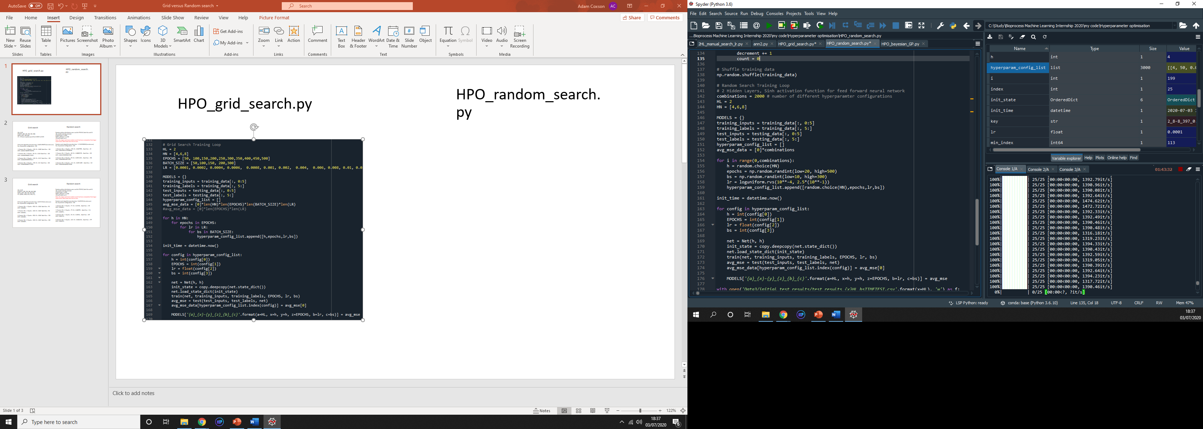
HPO_grid_search.py
HPO_random_search.py

Slide 7
Grid search
Random search
HN = [4,8]
EPOCHS = [50, 100, 150, 200, 300]
BATCH_SIZE = [60,100]
LR = 10 values equally spaced from 0.0002 to 0.020
Grid search algorithm execution time: 0:38:53.953573 (hrs:mins:secs)
No. of parameter configurations: 200
1 ) Params: HN = 8 Epochs = 100 LR = 0.008 Batch Size = 100
MSE: 0.003322…
2 ) Params: HN = 8 Epochs = 50 LR = 0.018 Batch Size = 100
MSE: 0.003908…
3 ) Params: HN = 8 Epochs = 100 LR = 0.012 Batch Size = 100
MSE: 0.004047…
4 ) Params: HN = 8 Epochs = 150 LR = 0.01 Batch Size = 100
MSE: 0.004096…
Random uniform distributions were used for EPOCHS, Batch Size and LR. HN = [4,8] (randomly selected) EPOCHS from 1 to 500 BATCH_SIZE from 1 to 300 LR from 0.0001 to 0.1 Note, the ranges used mean random search had more computation from larger epoch values which take more time to train. Random search algorithm execution time: 1:12:08.963038 (hrs:mins:secs)
No. of parameter configurations: 200
1 ) Params: HN = 4 Epochs = 270 LR = 0.0647765… Batch Size = 49
MSE: 0.004256…
2 ) Params: HN = 8 Epochs = 86 LR = 0.06869176… Batch Size = 282
MSE: 0.004329…
3 ) Params: HN = 8 Epochs = 95 LR = 0.09231202… Batch Size = 150
MSE: 0.004899…
4 ) Params: HN = 8 Epochs = 231 LR = 0.00911087… Batch Size = 242
MSE: 0.004946…
Grid search outperformed random search – However, domain spaces are not equivalent.

Slide 8
Grid search
Random search
Random uniform distributions were used for EPOCHS and Batch Size. A uniform logarithmic distribution was taken for LR. HN = [4,8] (randomly selected) EPOCHS from 20 to 500 BATCH_SIZE from 10 to 300 LR from 0.0001 to 0.20 Random search algorithm execution time: 0:44:50.54 (hrs:mins:secs)
No. of parameter configurations: 200
1 ) Params: HN = 8 Epochs = 72 LR = 0.01746… Batch Size = 215
MSE: 0.004604…
2 ) Params: HN = 8 Epochs = 79 LR = 0.008759… Batch Size = 214
MSE: 0.004694…
3 ) Params: HN = 4 Epochs = 54 LR = 0.03934… Batch Size = 287
MSE: 0.004718…
4 ) Params: HN = 8 Epochs = 482 LR = 0.0004220… Batch Size = 277
MSE: 0.004970…
HN = [4,8]
EPOCHS = [100, 200, 300, 400, 500]
BATCH_SIZE = [50, 100, 200, 300]
LR = [0.002, 0.004, 0.02, 0.04, 0.1]
Grid search algorithm execution time: 0:49:25.28 (hrs:mins:secs)
No. of parameter configurations: 200
1 ) Params: HN = 4 Epochs = 500 LR = 0.004 Batch Size = 50
MSE: 0.004060…
2 ) Params: HN = 4 Epochs = 400 LR = 0.002 Batch Size = 50
MSE: 0.004304…
3 ) Params: HN = 4 Epochs = 500 LR = 0.004 Batch Size = 200
MSE: 0.004360…
4 ) Params: HN = 8 Epochs = 300 LR = 0.002 Batch Size = 300
MSE: 0.004405…
Grid search outperformed random search. Domain spaces more appropriate/equal. Need more parameter configurations?

Slide 9
Grid search
Random search
Random uniform distributions were used for EPOCHS and Batch Size. A uniform logarithmic distribution was taken for LR. HN = [4,6,8] (randomly selected) EPOCHS from 20 to 500 BATCH_SIZE from 10 to 300 LR from 0.0001 to 0.25 Random search algorithm execution time: 13:18:23 and 7:57:26 No. of parameter configurations: 3000 and 2000
3000 over 13:18:23
1 ) Params: HN = 8 Epochs = 152 LR = 0.003947… Batch Size = 104
MSE: 0.003672…
2 ) Params: HN = 6 Epochs = 379 LR = 0.0005412… Batch Size = 11
MSE: 0.003905…
2000 over 7:57:26
1 ) Params: HN = 6 Epochs = 402 LR = 0.0003725… Batch Size = 26
MSE: 0.004061…
2 ) Params: HN = 6 Epochs = 117 LR = 0.02716… Batch Size = 76
MSE: 0.004236…
HN = [4,6,8]
EPOCHS = [50, 100,150,200,250,300,350,400,450,500] BATCH_SIZE = [50,100,150, 200,300] LR = 20 manually selected values from 0.0001 to 0.25
Grid search algorithm execution time: 10:57:39 (hrs:mins:secs)
No. of parameter configurations: 3000
1 ) Params: HN = 4 Epochs = 150 LR = 0.01 Batch Size = 50
MSE: 0.003392…
2 ) Params: HN = 8 Epochs = 250 LR = 0.001 Batch Size = 50
MSE: 0.003953…
3 ) Params: HN = 8 Epochs = 450 LR = 0.0006 Batch Size = 50
MSE: 0.004010…
4 ) Params: HN = 6 Epochs = 200 LR = 0.001 Batch Size = 50
MSE: 0.004222…
Grid search outperformed random search ... Again. Need more sparse data.

Slide 10
Grid search
Random search
Random uniform distributions were used for EPOCHS and Batch Size. A uniform logarithmic distribution was taken for LR. HN = [4,6,8] (randomly selected) EPOCHS from 20 to 500 BATCH_SIZE from 10 to 300 LR from 0.0001 to 0.25 Random search algorithm execution time: 1:18:18.38 (hrs:mins:secs)
No. of parameter configurations: 288
1 ) Params: HN = 6 Epochs = 393 LR = 0.001177… Batch Size = 180
MSE: 0.003786…
2 ) Params: HN = 8 Epochs = 444 LR = 0.003883… Batch Size = 253
MSE: 0.004293…
3 ) Params: HN = 6 Epochs = 272 LR = 0.001067… Batch Size = 54
MSE: 0.004613…
4 ) Params: HN = 8 Epochs = 261 LR = 0.001275… Batch Size = 191
MSE: 0.004687…
HN = [4,8]
EPOCHS = [50,150,400, 500]
BATCH_SIZE = [50, 300, 400]
LR = [0.0001, 0.0004, 0.0008, 0.001, 0.004, 0.008, 0.01, 0.04, 0.08, 0.1, 0.2, 0.25]
Grid search algorithm execution time: 1:05:29.37 (hrs:mins:secs)
No. of parameter configurations: 288
1 ) Params: HN = 8 Epochs = 150 LR = 0.01 Batch Size = 300
MSE: 0.004023…
2 ) Params: HN = 4 Epochs = 400 LR = 0.001 Batch Size = 50
MSE: 0.004485…
3 ) Params: HN = 8 Epochs = 50 LR = 0.004 Batch Size = 50
MSE: 0.004568…
4 ) Params: HN = 4 Epochs = 500 LR = 0.001 Batch Size = 400
MSE: 0.004876…
Grid search outperformed random search ... And again

Slide 11
Grid search
Random search
HN: H1 = 4, H2 = 8 EPOCHS from 20 to 500 BATCH_SIZE = 300 LR from 0.0001 to 0.25 Random search algorithm execution time: 0:27:46.021268 (hrs:mins:secs)
No. of parameter configurations: 400
1 ) Params: HN = 6 Epochs = 296 LR = 0.007606 Batch Size = 300
MSE: 0.003713
2 ) Params: HN = 4 Epochs = 280 LR = 0.004261 Batch Size = 300
MSE: 0.003851
3 ) Params: HN = 6 Epochs = 266 LR = 0.005205 Batch Size = 300
MSE: 0.004444
4 ) Params: HN = 4 Epochs = 109 LR = 0.004678 Batch Size = 300
MSE: 0.004554
HN: H1 = 4, H2 = 8
EPOCHS = [30, 60, 90, 120, 150, 180, 210, 240, 270, 300, 330, 360, 390] BATCH_SIZE = 300
LR = 0.0001 to 0.0009, 0.001 to 0.009, 0.01 to 0.09, 0.1 to 0.25.
Grid search algorithm execution time: 0:29:17.470747 (hrs:mins:secs)
No. of parameter configurations: 403
1 ) Params: HN = (4,8), Epochs = 330 LR = 0.008 Batch Size = 300
MSE: 0.004054
2 ) Params: HN = (4,8), Epochs = 270 LR = 0.002 Batch Size = 300
MSE: 0.004475
3 ) Params: HN = (4,8), Epochs = 120 LR = 0.08 Batch Size = 300
MSE: 0.004626
4 ) Params: HN = (4,8), Epochs = 150 LR = 0.03 Batch Size = 300
MSE: 0.004649
This time, performances were similar. So … again.

Slide 12
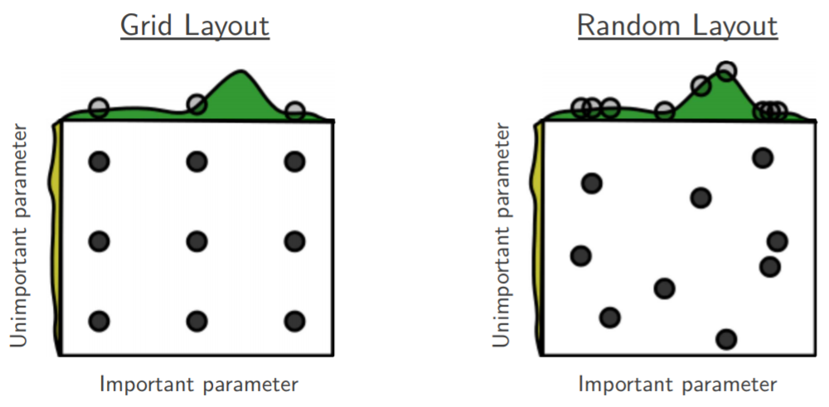
Grid search better than Random?
Random search has no improvement over grid search if the hyperparameter intervals are ‘saturated’.
Benefit of Random search only becomes available for extremely large data sets, well over 2000 combinations.
My current Random search algorithm changes the neural network each iterations whereas Grid retains the same network until all of it’s relevant configurations have been tested. However, this network initialisation time appears to be negligible after some crude tests.
Maybe my random sampling method is not erratic enough? np.random.uniform()

Slide 13

Gaussian Process Bayesian Optimisation
Attempting to make scripts via Python Package APIs. Difficult to implement with current form of neural network. The image shows 4 different scripts I am messing round with. None of them work yet. Could either: Code the stats and algorithm from scratch. Find a neural network compatible with a package API (i.e. KERAS?).

Slide 14
Week 2
Week Aims:
Form a working module for Gaussian process Bayesian Optimisation
Do some reading into Evolutionary Algorithms
Generate a heat map to demo GP Bayesian optimisation
Think about moving onto the experimental data provided.
Up to this point I have only used the data and training procedure for the neural networks developed by Mo. I need to look at creating a new and more robust equivalent to train.py and test.py modules.

Slide 15
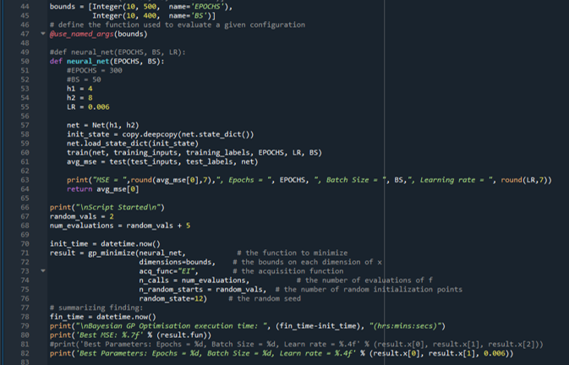
Gaussian Process Bayesian Optimisation
On wednesday 08/07/2020 I managed to finally figure out how to get a working Bayesian optimisation script. I achieved this using a function from the Scikit Optimise package skopt.gp_minimize().
The image below shows a section of my code, which is still currently in development. At the top, the hyperparameters and their min/max boundaries are defined, I also extended this script to include learning rate as a hyperparameter. Next, the neural network is wrapped in a function where the function arguments and output is compatible with the operation of gp_minimize(). Finally, the bottom half shows the actual call of gp_minimize, n_calls = total number of calls, n_random_start = randomly selected points to initialise before operating the actual GP Bayes Opt. The acquisition function is "EI", Expected Improvement.

Slide 16

Example output
Each line of this data shows an iteration of gp_minimize after I had extended the script to account for learning rate, Epoch and batch size number. This data had 25 points in total, 10 initial random points with the latter 15 points the actual Bayesian optimisation. What is interesting to note is how the algorithm settles on 290 Epochs and a Batch size of 181 quite quickly.
The values were chosen simply for fast computation for demonstration purposes. In actual runs I would more likely use 30 random initial points and

Slide 17
Gaussian Process Bayesian Optimisation
After successfully making a script for Bayesian Optimisation I have taken steps to analyse its performance.
I will create a mesh of data, using grid search and varying the Batch size and number of Epochs while keeping the learning rate, hidden layers and hidden neuron numbers constant.
LR = 0.006, 2 layers of 4 and 8 neurons. Epochs = 10 to 500, Batch = 10 to 400.
This mesh can be used to generate a heatmap overlayed with the outputs of Bayesian optimisation to demonstrate how the algorithm works.
Furthermore, this will help me see if the domain space is consistent. If I run the grid search algorithm 4 times, I expect to see the same heat map each time. If it’s inconsistent, I’ll need to find out why.

Slide 18
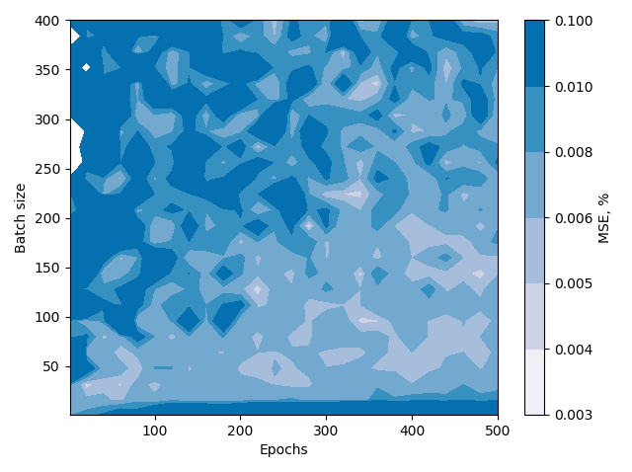
Grid search heat map mesh
Created 3 data sets for grid search output using the following data EPOCHS = np.linspace(0,500,26), BATCH_SIZE = np.linspace(0,400, 26), LR = 0.006, HN = (4, 8).
The grid search was ran on my laptop which took a lot longer to execute than expected.
Some rough heatmaps were plotted as shown below. I probably need a finer mesh of data and to work out a more intuitive colour scheme.
3 plots of separate data runs all had consistent features and looked similar.
Figure: Heatmap of MSE output for varied batch size and epoch number at a learning rate of 0.006 with 2 hidden layers of 4 and 8 neurons respectively.

Slide 19
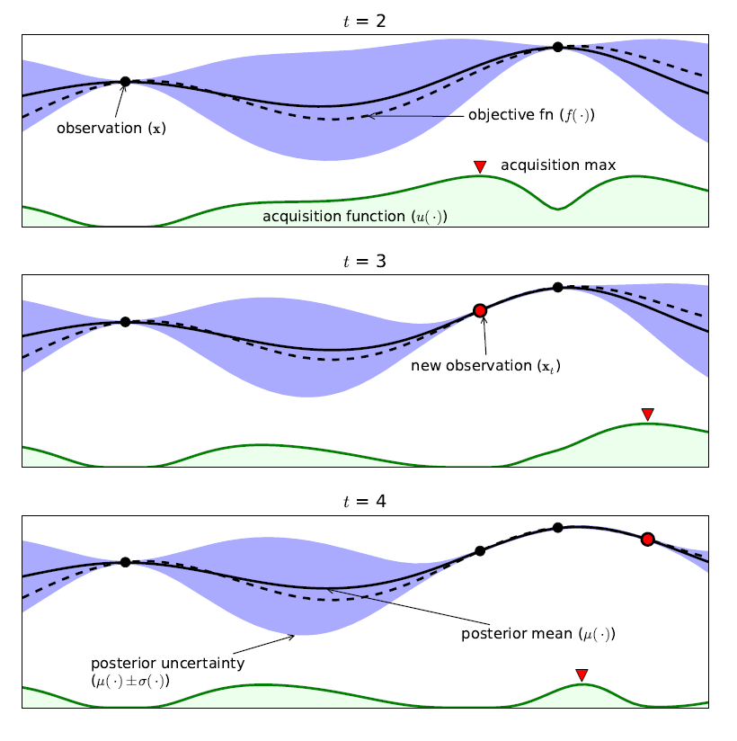
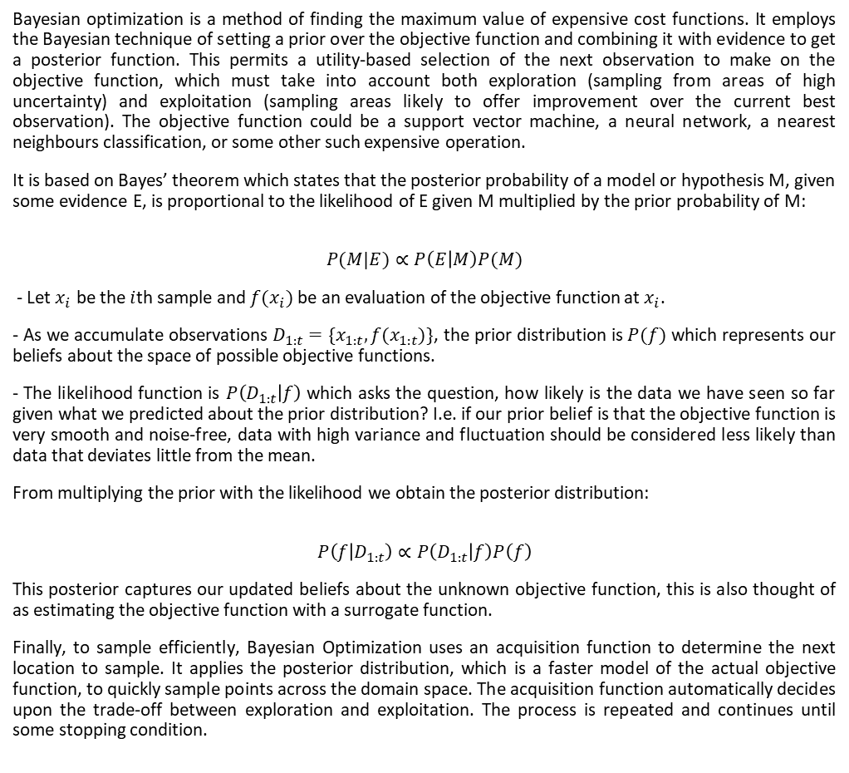
What is Bayesian Optimisation?
Bayesian optimization is a method of finding the maximum value of expensive cost functions. It employs the Bayesian technique of setting a prior over the objective function and combining it with evidence to get a posterior function. This permits a utility-based selection of the next observation to make on the objective function, which must take into account both exploration (sampling from areas of high uncertainty) and exploitation (sampling areas likely to offer improvement over the current best observation). The objective function could be a support vector machine, a neural network, a nearest neighbours classification, or some other such expensive operation.
It is based on Bayes’ theorem which states that the posterior probability of a model or hypothesis M, given some evidence E, is proportional to the likelihood of E given M multiplied by the prior probability of M:
$$P(M|E)∝P\left(E | M\right)P(M)$$
- Let $x_{i}$ be the $i$th sample and $f(x_{i})$ be an evaluation of the objective function at $x_{i}$.
- As we accumulate observations $D_{1:t}=\{x_{1:t},f(x_{1:t})\}$, the prior distribution is $P(f)$ which represents our beliefs about the space of possible objective functions.
- The likelihood function is $P\left(D_{1:t} | f\right)$ which asks the question, how likely is the data we have seen so far given what we predicted about the prior distribution? I.e. if our prior belief is that the objective function is very smooth and noise-free, data with high variance and fluctuation should be considered less likely than data that deviates little from the mean.
From multiplying the prior with the likelihood we obtain the posterior distribution:
$$P\left(f | D_{1:t}\right)∝P\left(D_{1:t} | f\right)P\left(f\right)$$
This posterior captures our updated beliefs about the unknown objective function, this is also thought of as estimating the objective function with a surrogate function.
Finally, to sample efficiently, Bayesian Optimization uses an acquisition function to determine the next location to sample. It applies the posterior distribution, which is a faster model of the actual objective function, to quickly sample points across the domain space. The acquisition function automatically decides upon the trade-off between exploration and exploitation. The process is repeated and continues until some stopping condition.

Slide 20
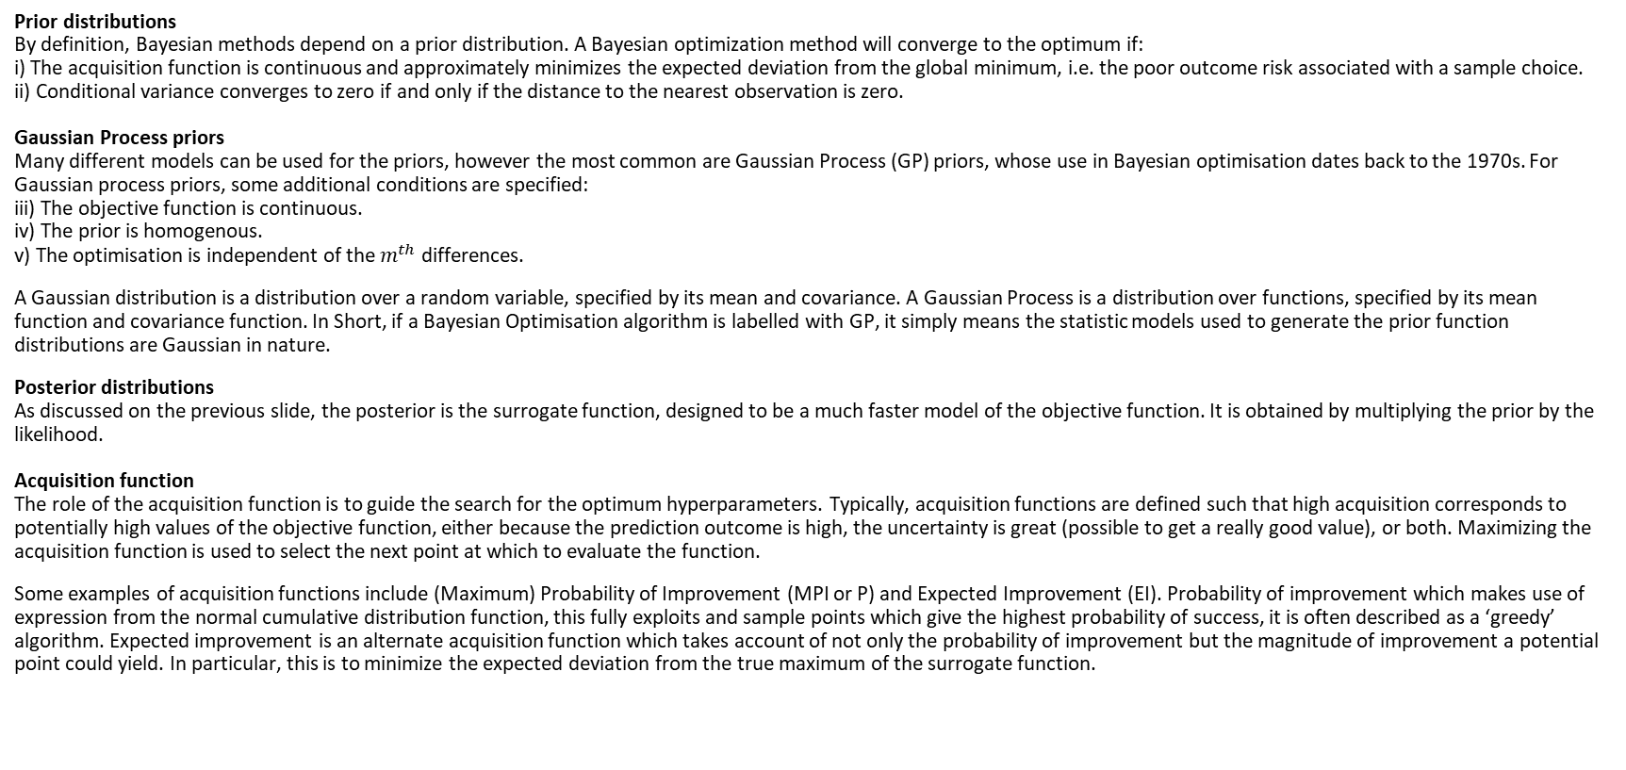
What is Bayesian Optimisation?
Prior distributions By definition, Bayesian methods depend on a prior distribution. A Bayesian optimization method will converge to the optimum if: i) The acquisition function is continuous and approximately minimizes the expected deviation from the global minimum, i.e. the poor outcome risk associated with a sample choice. ii) Conditional variance converges to zero if and only if the distance to the nearest observation is zero. Gaussian Process priors Many different models can be used for the priors, however the most common are Gaussian Process (GP) priors, whose use in Bayesian optimisation dates back to the 1970s. For Gaussian process priors, some additional conditions are specified: iii) The objective function is continuous. iv) The prior is homogenous. v) The optimisation is independent of the $m^{th}$ differences.
A Gaussian distribution is a distribution over a random variable, specified by its mean and covariance. A Gaussian Process is a distribution over functions, specified by its mean function and covariance function. In Short, if a Bayesian Optimisation algorithm is labelled with GP, it simply means the statistic models used to generate the prior function distributions are Gaussian in nature.
Posterior distributions As discussed on the previous slide, the posterior is the surrogate function, designed to be a much faster model of the objective function. It is obtained by multiplying the prior by the likelihood. Acquisition function The role of the acquisition function is to guide the search for the optimum hyperparameters. Typically, acquisition functions are defined such that high acquisition corresponds to potentially high values of the objective function, either because the prediction outcome is high, the uncertainty is great (possible to get a really good value), or both. Maximizing the acquisition function is used to select the next point at which to evaluate the function.
Some examples of acquisition functions include (Maximum) Probability of Improvement (MPI or P) and Expected Improvement (EI). Probability of improvement which makes use of expression from the normal cumulative distribution function, this fully exploits and sample points which give the highest probability of success, it is often described as a ‘greedy’ algorithm. Expected improvement is an alternate acquisition function which takes account of not only the probability of improvement but the magnitude of improvement a potential point could yield. In particular, this is to minimize the expected deviation from the true maximum of the surrogate function.

Slide 21

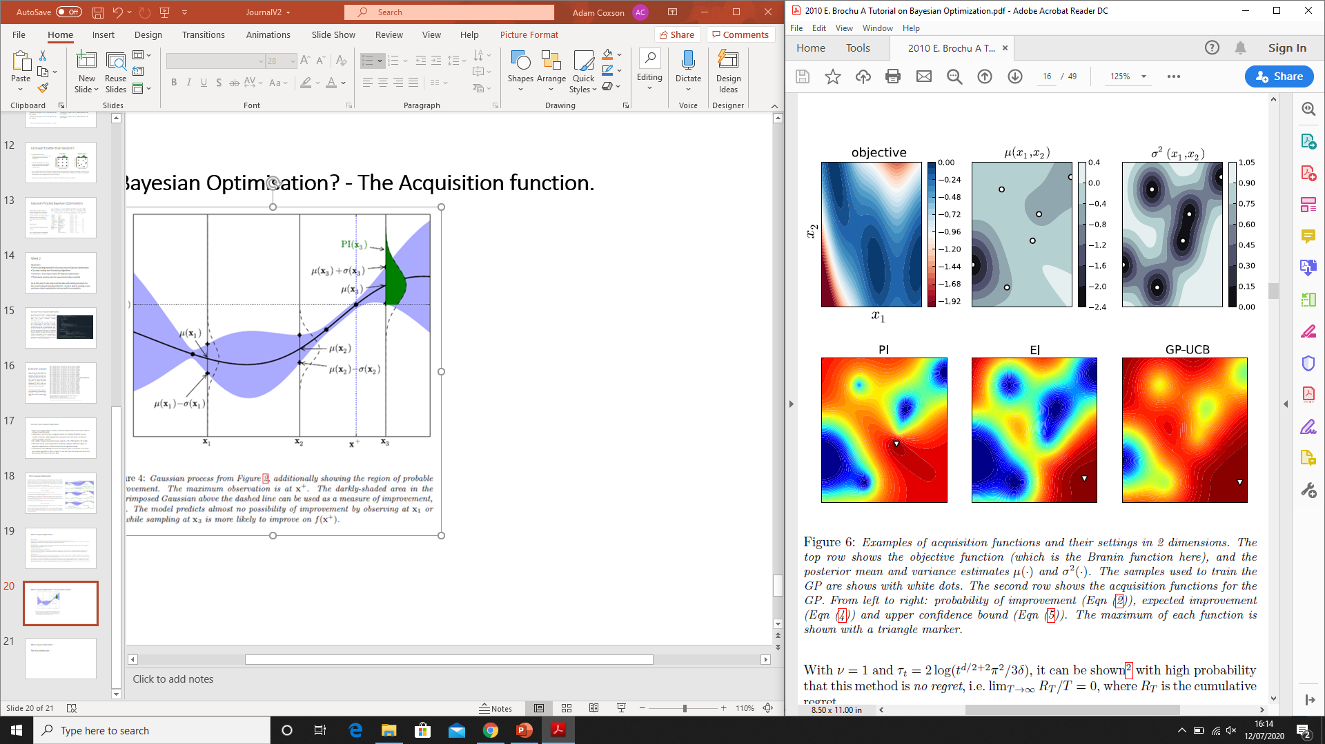
What is Bayesian Optimisation? - The Acquisition function.
[REF] E. Brochu, V. M. Cora, and N. Freitas, “A Tutorial on Bayesian Optimization of Expensive Cost Functions, with Application to Active User Modeling and Hierarchical Reinforcement Learning”, 2010

Slide 22
What is Bayesian Optimisation?
The Pros and the cons
The design of the prior is critical to efficient Bayesian Optimisation, GPs are not always the best of easiet solution. Even if they are, care must be taken in design of the kernel. The Objective function is expensive to sample. So ultimately in the absence of expensive data sets, either strong assumptions are made without certainty that they are valid, or a weak prior must be used. It is often unclear how to handle the trade off between exploration and exploitation. To much exploration, iterations go by without improvement whereas too much exploitation leads to local maximisation. This problem becomes even more apparent as dimensionality increases which requires more samples to cover the domain space. To deal with this may require higher level, automated feature selection ot assume independenceand optimise each hyperparameter separately.

Slide 23
End of Week 2
Week Aims reminder:
Form a working module for Gaussian process Bayesian Optimisation
Do some reading into Evolutionary Algorithms - Seen some promising links today which give code/package examples
Generate a heat map to demo GP Bayesian optimisation - Heat map works but need finer data and to overlap Bayes Opt
Think about moving onto the experimental data provided. - I think I know what I need to edit but haven’t had chance to try it.

Slide 24
Week 3
Week aims:
1) Form a system to use Dongda’s experimental data rather than Mo’s. Compare the optimal configurations for Grid, random and bayes for this data.
2) Read up on Evolutionary algorithms and begin to implement. See code provided by Tom Savage.
3) Develop a different variant of Bayes Opt

Slide 25
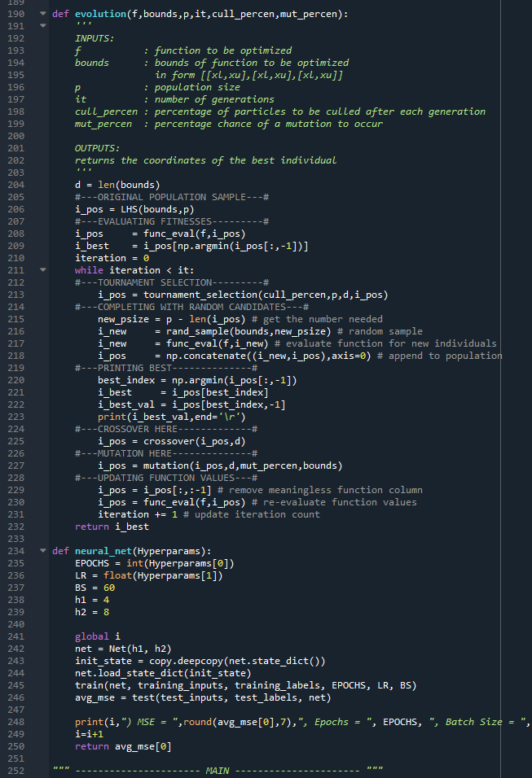
Evolutionary Algorithm
As per my second aim for week 3, I looked into evolutionary algorithms.
The code provided by Tom Savage worked right away with only minimal adjustments. However, the execution time seems to take a long time when using an expensive neural network as the objective function.
The initial settings of a population size of 60 with 1000 generations resulted in 120,000 evaluations of the default test function, which was low compared to typical E.A. standards. However, anything above 3000 iterations is useless for our neural network.
Changing the population size to 20 and putting generations down to 10 resulted in a more suitable number of evaluations for the expensive neural network. However, this defeats the point of using an evolutionary algorithm which utilises a large population base with fit parent crossover and a small amount of mutation per generation.

Slide 26
Evolutionary Algorithm
There does not seem to be any obvious way to edit the E.A. and make it more efficient as the code is already a simple, low level architecture. There are only three options I see:
Run the E.A. directly via the neural network on some cluster for a long amount of time. To reduce execution times, parallelisation can be exploited, possibly also reduction of training data and constraining the domain space as much as possible.
Accept the E.A. as is and conclude it is not a viable option to optimise the hyperparameters of an expensive neural network.
Develop a Surrogate-based Evolutionary Algorithm. Similar to the posterior distribution in Bayesian Optimisation, a surrogate could be used to model the neural network. An initial seeding would help build some surrogate estimates. The surrogate could then act as the objective function and be improved after each generation. Furthermore, sometimes the neural network could be directly evaluated during the algorithm to check the surrogate and ensure convergence.
The 3rd option of a surrogate model would be ideal. However, trying to code this may be quite time consuming and draw efforts away from different models which could be evaluate. If a premade version can be sourced from somewhere, it would save me a lot of time.
On the contrary, implementing parallelisation and running on a high-core computer cluster could bring a similar performance boost.

Slide 27

New Experimental data
Dongda provided different experimental data from what is used in Mo’s code, which is what I have been using thus far. This data had varying Biomass concentration over time, as well as constant initial conditions for Gas Aeration rate, C02 concentration and Light intensity.
Mo’s data had varying Biomass concentration, Lutein production, Nitrogen concentration and constant Light intensity and Nitrate concentration.
I used the same data processing method as Mo and modified the modules, ANN_B, train_B, test_B, data_preprocessing_B and replicate_B to work with the new data set.
This seemed to work and from an initial run using Bayesian optimisation I obtained MSE values bounded between 0.12 and 0.01. This seems valid, however it does not get as low as 0.004 like in analysing the original data.
I now need to figure out if the current range is output I should be getting and whether 1% error is the lowest possible or if something is going wrong to limit the minimum to 1%.
I also need to better select which Experiment numbers to use as my training and testing dataset. I’ve currently selected a testing set of experiments 3, 7, 9, 18 and 22.

Slide 28
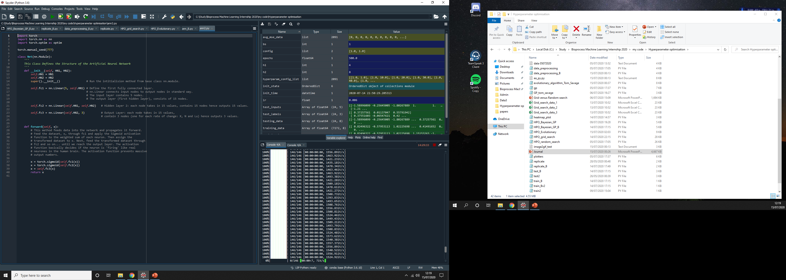

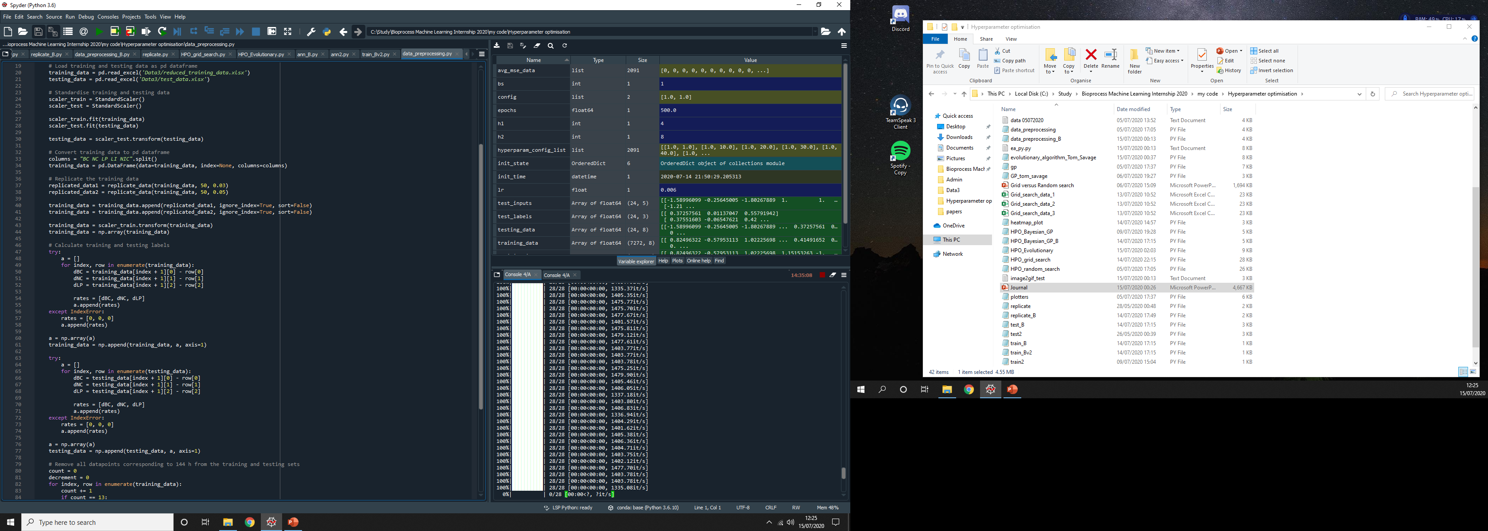
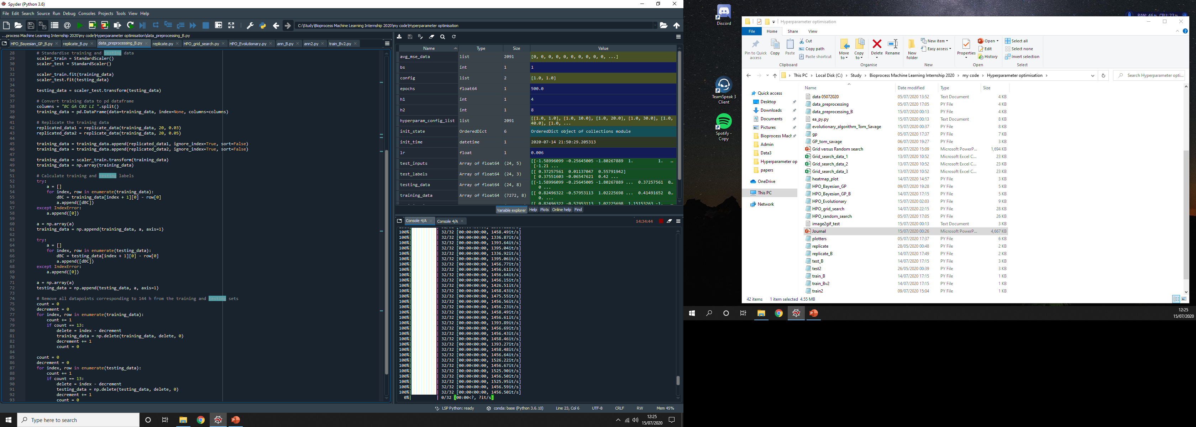
New Experimental data – Dataset B
ann.py
Original
Modified
ann_B.py
data_processing.py
data_processing_B.py

Slide 29
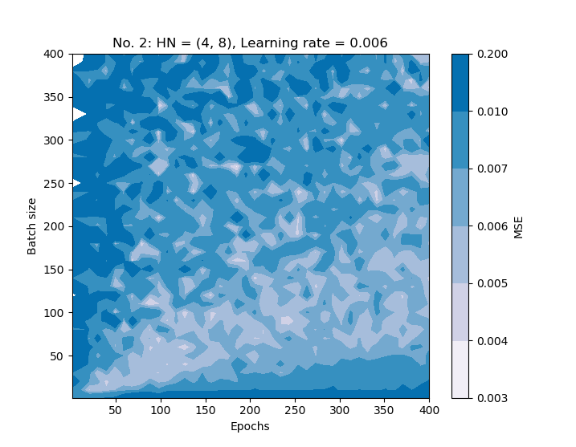
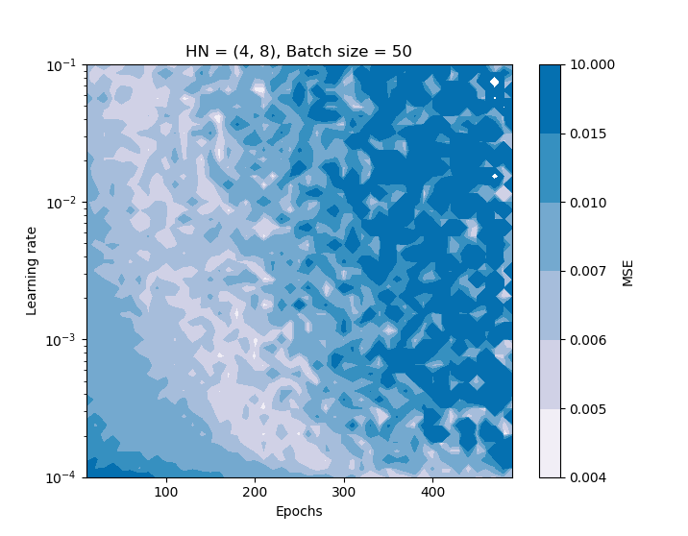
Identifying trends in the domain space
These plots were obtained from Mo’s original data set, dataset_A and his training procedure. They enable identification of low MSE regions within the domain space.

Slide 30
Evaluating the performance of Grid search, Random search and GP Bayesian optimisation
Thursday 16/07/2020
Using the new experimental data processing, I am going to evaluate the performance of grid search, Random search and Gaussian process Bayesian optimisation.
To start, I need to gain an understanding of the trends within the domain space. I’ll do this by investigating the optimal neuron configuration and then analysing epochs versus batch size and epochs versus learning rate. This can be done using heatmaps.
After I have gained some a-priori understanding of the domain space I will conduct a mock investigation where I’ll fully evaluate grid search, random search and Bayesian optimisation, up to 4 dimensions; neuron number, epochs, batch size, learning rate. I will constrain the system to two hidden layers and the sigmoid activation function.
Hopefully, the full hyperparameter optimisation procedure will identify a configuration that resides within the optimal region of the domain space. It is predicted that Bayesian Optimisation should be able to identify this too, much more quickly than grid or random search.

Slide 31
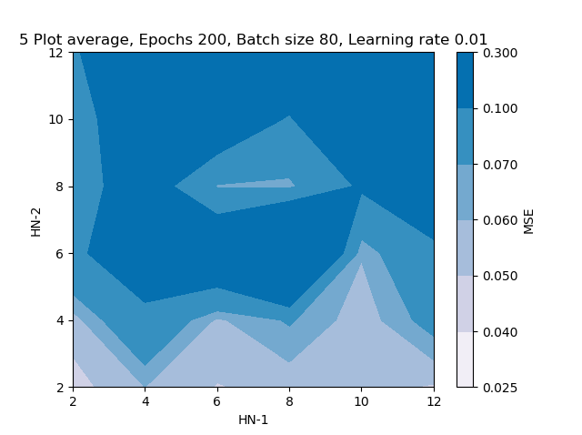
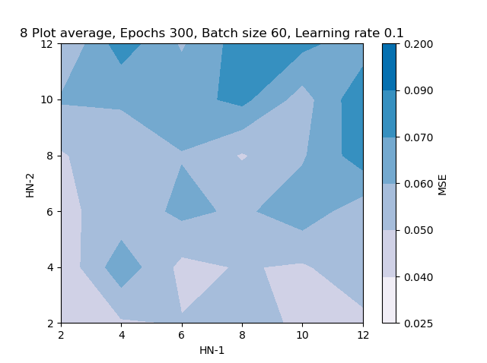
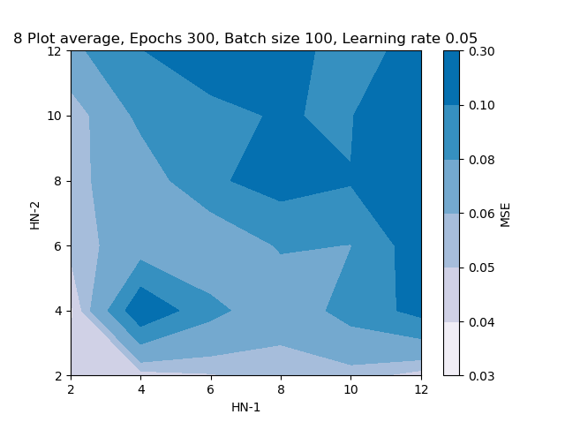
Finding the best hidden networks configuration
I used grid search for even H1 and H2 values drawn from 2 to 12. The Epochs, batch size and Learning rate were arbitrarily chosen, taking mid range values. Two hidden layers with the sigmoid activation function were kept as constants.
I repeated these several times, averaged and plotted the results as a heatmap to help me identify the best sets of neuron numbers.
These plots seems to indicate that the optimal HN-1 values include 2, 4, 6, 8 and 10. These are bounded by 2 and 4 as the optimal values for HN-2. So, one could choose (H1, H2): (6,4), (8,4), (2,2), (10,2). These are all valid examples. I was not entirely satisfied with this, but I was methodical and this was the result.

Slide 32
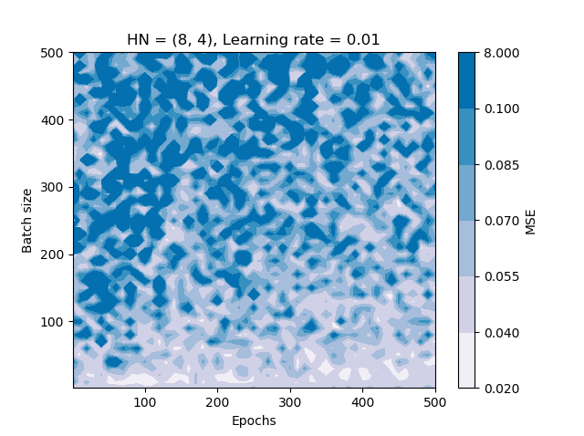
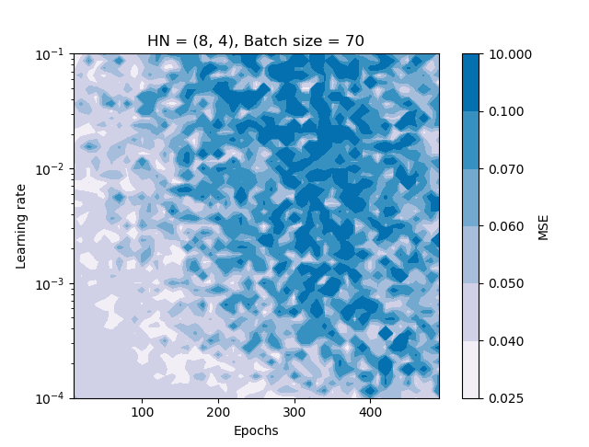
Finding the optimal domain space
After analysing the MSE outputs for the hidden networks, I chose a neuron number configuration of (8, 4) to use for further analysis.
Both epoch number and batch size were varied from 0 to 500, with a learning rate of 0.01. Epoch number and learning rate was also varied at a batch size of 70. These distributions were plotted as a heat maps.
These plots for the experimental, dataset B follow the same distribution as for dataset A. The major difference was that Mo’s data achieved lower MSE levels of 0.003 to 0.01 whereas B only achieved 0.02 to 0.05.
Conclusions: -Neuron numbers. H1 can be from 10 to 2, H2 can be 2 or 4. -Batch size is ideally less than 100. -Epochs, ideally 200 or less. -Learning rate between 0.01 and 0.0001 provided epoch number is low enough.
Example optimal configuration: HN (8, 4), batch size 60, Epoch number 150, learning rate 0.001.

Slide 33
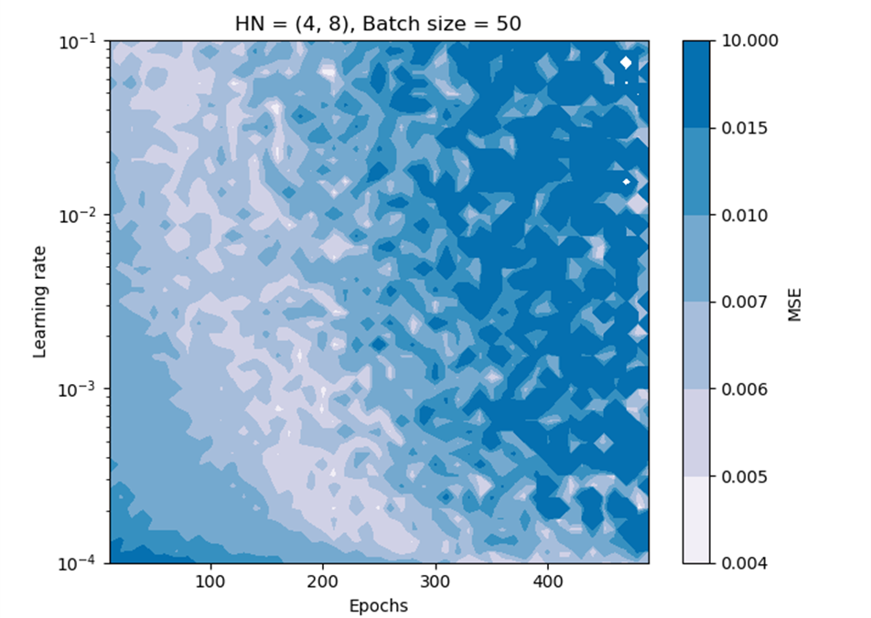
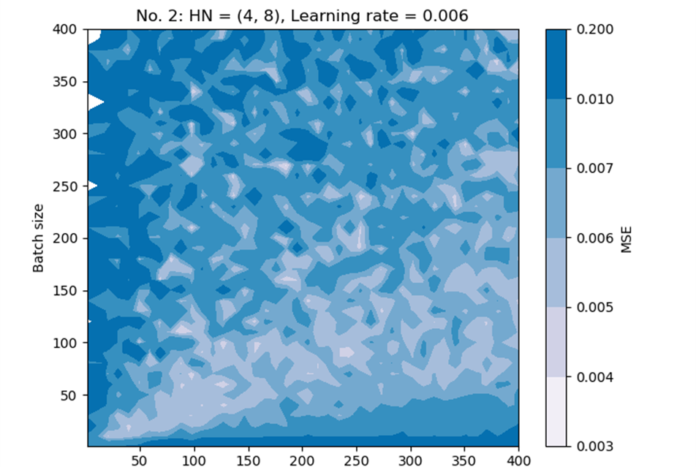
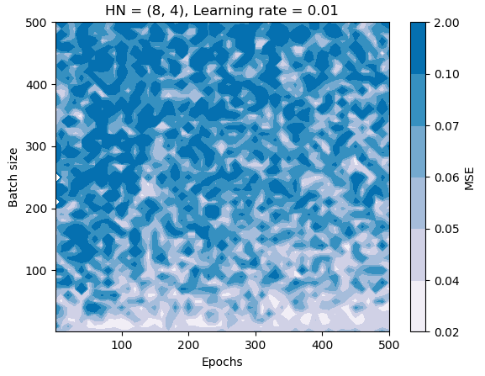

Slide 34
Evaluating the performance of Grid search, Random search and GP Bayesian optimisation
Now that we have an intuitive understanding of the optimal domain space, we can run grid and random search and Bayesian optimisation under more realistic pretences and do a full optimisation procedure from start to finish.
The steps I took to search the domain space could also be used as a manual tuning procedure in itself:
Plot a heatmaps of Hidden Layers, neuron numbers and activation functions. Identify the optimal regions for these hyperparameters.
For a given configuration of neurons, layers and activation function, investigate the relationship between ‘Epochs and learning rate’, ‘Epochs and batch size’ as well as ‘batch size and learning rate’.
Identifying the optimal regions from each of these plots will help the tuner further constrain the hyperparameters to the optimal region of the domain space.

Slide 35
Evaluating the performance of Grid search, Random search and GP Bayesian optimisation
To save time, I will limit the hidden neuron numbers to 2, 4, 6, 8, 10 for H1 and 2, 4, 6 for H2. Two hidden layers and the sigmoid activation function will be used also.
Epochs will be varied from 10 to 400, more due to the fact that high epoch numbers result in long execution time, and we already know that more than 300 is not optimal.
Batch size will be varied from 1 to 300.
Learning rate will be varied from 0.0001 to 0.1 (and maybe up to 0.2, 0.3).
Using these initial bounds, a full, 4 dimensional search of the hyperparameter space will be conducted.
N.B. Random forests may also be evaluated in the same way as Gaussian Process Bayesian Optimisation.

Slide 36
End of Week 3
Week aims:
Form a system to use Dongda’s experimental data rather than Mo’s. Compare the optimal configurations for Grid, random and bayes for this data.
- The first part was successful and I manually searched the domain space and gained an intuition of the optimal hyperparameters. I still need to complete the full, mock evaluation and rank the performance.
2) Read up on Evolutionary algorithms and begin to implement. See code provided by Tom Savage.
- I’ve done some limited study into the concepts of cross-over and mutation per generation as well as some of the merits and drawbacks of E.A. It was quick and easy to implement Tom’s EA code, however, I ran into the problem of expensive objective functions which require surrogate modelling.
3) Develop a different variant of Bayes Opt.
- Didn’t bother
Lost time to memory error on a 40 hour Bayesian Optimisation. Computer cluster?

Slide 37
Week 4
Week aims:
Continue with a full evaluation of Grid search, Random search and Bayesian Optimisation.
2) Perform a two step method evaluation of grid search and Bayesian Optimisation
3) Write up reports

Slide 38
Implementing parallel processing
When trying to execute high dimensional code, I found that it was frustratingly slow and on several occasions I had to give up and close some consoles, losing hours worth of data.
I decided it was necessary to parallelise the grid and random search processes to save time.
Another benefit is that I can run these operations on the shared computational facility I gained access to this week, which has many high speed cores for me to use!
Below is the run time results of parallel processing on my desktop; Intel i7 8700K 3.7 GHz quad core processor. This was done for 209 configurations, varying learning rate and epoch number.
Single core time: 59:27 mins Dual core time: 28:32 – 2.1x faster Quad core time: 14:01 – 4.25x faster. CPU at approximately 40% capacity. Octa core time: 8:52 – 6.8x faster. CPU approximately at 70% full capacity. Ten core time: 8:01 – 7.4x faster. Here my CPU was at 84 to 99% capacity, a bit too high for my liking! 16 cores: tried it, CPU shot up to 100%, killed the console. Wouldn’t risk it for a chocolate biscuit.
So, I could safely run a grid or random search with 8 cores and let the system idle. This would achieve a 7 fold speed increase. Even though I only have 4 cores, the CPU is able to spread the load of the 8 processes between the 4 cores and still achieve significant speed improvement.

Slide 39
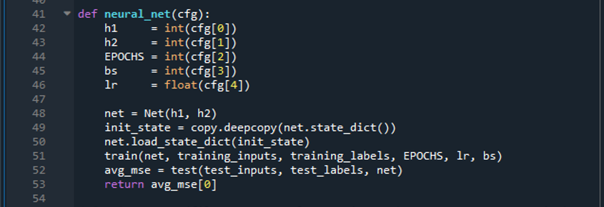
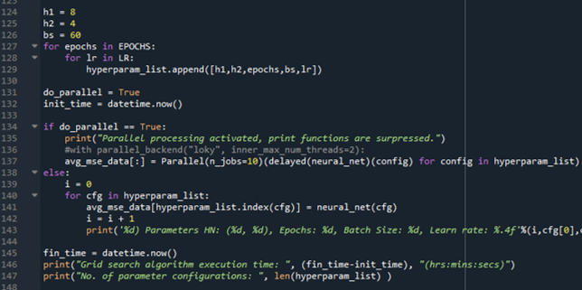
Parallel processing
Here are images of the relevant code snippets and some details. This is simply for reference. Relevant code lines: from joblib import Parallel, delayed EPOCHS = np.linspace(10,300,11)
LR = np.round(np.logspace(-4, -1, num = 19),6)
This resulted in 209 configurations in total.

Slide 40
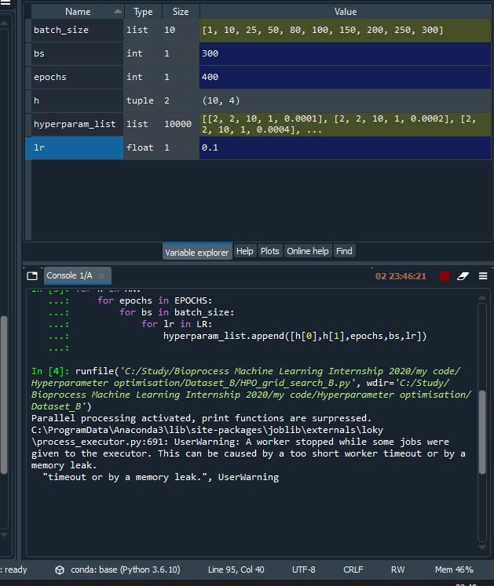
Ran a grid search over HN, Epochs, batch size and learning rate. Each of 10 values giving 10,000 combinations. With 8 processors, should have taken 20 hours, took 48 before I had to kill it.
If not for technical difficulties I would have data for Grid Search, Random Search, Gaussian Process Bayesian Optimisation and Random Forest.
Positive note: Have access to the clusters so can run these with many more processors and more memory. No need to leave my personal PC idling for 28 hours at a time.

Slide 41
Week 4
Reminder of Week aims:
Continue with a full evaluation of Grid search, Random search and Bayesian Optimisation.
2) Perform a two step method evaluation of grid search and Bayesian Optimisation.
Failed both of these due to technical problems. Can now use the cluster instead.
3) Write up reports.
Made a good start on the report but still needs polishing and refining. Have also managed to implement multiprocessing which will save a lot of time.

Slide 42
Week 5
Week aims:
Start setting up RNN for evaluations. Gain an approximate understanding of its capabilities.
Continue with evaluations of the different optimisation methods by submission to clusters.
Continue writing and refining the report.
Add ANN prediction plot for an optimal configuration

Slide 43
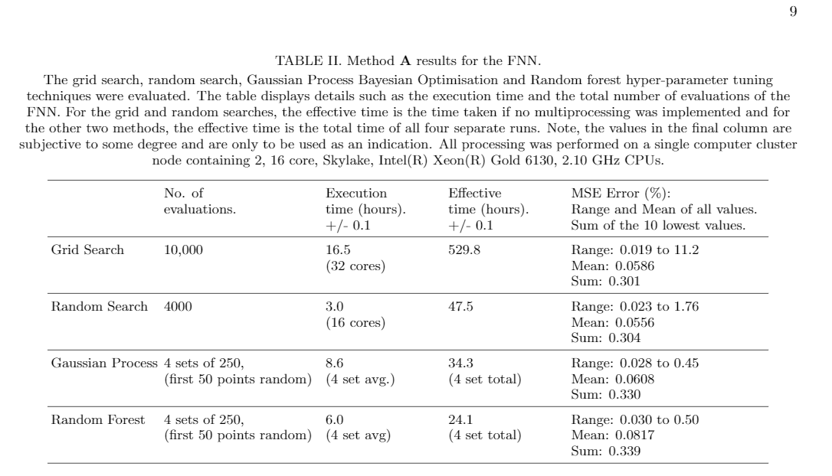

Slide 44
FNN results (See report for more details)
As expected, Gaussian Process Bayesian optimisation out performed all the other techniques in identifying an optimal configuration of hyperparameters.
Random Search performed better than Grid search.
Still need grid search to get a proper, full understanding of the domain space.
I’d probably choose Random search over Random Forest as the latters results seem sub-optimal and misleading.
The two-step method, reduces execution time to 20 % of a single, full dimensional run.
Bayesian Optimisation > Random Forest > Random Search > Grid Search

Slide 45
RNN
After some adjustments to the current .py modules and a new neural network module, an RNN can be evaluated.
The RNN is currently setup with 1 hidden layer and the Tanh activation function.
It runs faster than the FNN probably due to only having 1 layer.
I haven’t looked at anymore than 1 layer yet but its worthwhile to test.
Investigated Hidden neuron number from 1 to 20, epoch number from 40 to 400, batch size from 1 to 300 and learning rate from 0.1 to 0.0001.

Slide 46
RNN results
See Result outputs in Hyperparameter optimisation/RNN/Optimal results.txt.
Notes: Execution times significantly lower than 2-layer FNN. No apparent performance improvement. Need to perform two-step method on RNN to figure out its domain space before I can draw conclusions.

Slide 47
Week 5
Week aims reminder:
Start setting up RNN for evaluations. Gain an approximate understanding of its capabilities. (Almost fully complete)
Continue with evaluations of the different optimisation methods by submission to clusters. (Fully complete – maybe do Method C too?)
Continue writing and refining the report. (Ongoing – good progress this week)
Add ANN prediction plot for an optimal configuration.
(Not done but is quick to implement)

Slide 48
Week 6 (Partial week, away Thurs-Sun)
Week aims:
Finish collecting data for analysis of the RNN.
Identify optimal configurations of hyper-parameters from each method.
Plot offline predictions and choose one that represents the accuracy of each hyperparameter optimisation technique.

Slide 49
Code error delay
In the test_module.py I found 3 lines responsible for averaging the MSE between each predicted and experimental value. These lines were hard coded to only account for 2 testing data sets whereas I had 5.
I had failed to spot this several weeks ago when changing the scripts to work for the experimental data provided by Dongda. This meant I had to quickly resubmit all of my jobs to the computer cluster and get all the data again. This delayed me by a couple days.

Slide 50
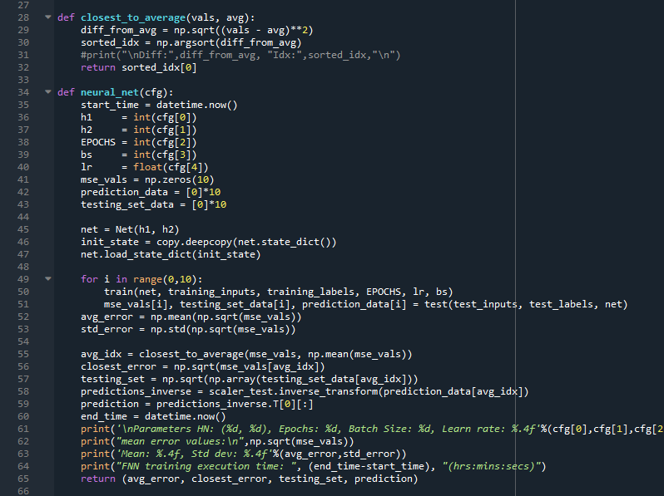
Test MSE variation
For the FFN, 4 optimal configurations were identified using Bayesian optimisation. These were then trained and tested 10 different times to obtain a mean and standard deviation for the MSE. The total execution time was 44 minutes. The relevant neural network code is shown on the right.
Parameters HN: (4, 8), Epochs: 125, Batch Size: 4, Learn rate: 0.0256 [0.04063528, 0.041117, 0.04095414, 0.04172329, 0.04144491, 0.04104938, 0.04075208, 0.04053769, 0.04038025, 0.04025587] Mean: 0.04088 ± 0.00044. (1%) (C)
Parameters HN: (4, 4), Epochs: 301, Batch Size: 23, Learn rate: 0.0983 [0.03425102, 0.03328818, 0.03801455, 0.03722947, 0.03910839, 0.03907152, 0.03941532, 0.03842429, 0.03779616, 0.03789512] Mean: 0.0374 ± 0.0020 (5%) (B) Parameters HN: (4, 8), Epochs: 126, Batch Size: 119, Learn rate: 0.0501 [0.05148526, 0.06100111, 0.05419258, 0.05646161, 0.05527827, 0.05508967, 0.06029235, 0.05823817, 0.05778039, 0.05874234] Mean: 0.0569 ± 0.0028 (5%) (D) Parameters HN: (4, 2), Epochs: 40, Batch Size: 97, Learn rate: 0.0243 [0.02786015, 0.03013806, 0.03190994, 0.03121583, 0.02990727, 0.03097654, 0.03164825, 0.03204272, 0.032297, 0.03247586] Mean: 0.0310 ± 0.0013 (4%) – (A)

Slide 51
Week 7
Continued from week 6
All data has been obtained by this point for both the RNN and FNN.
Multiple sets of optimal hyperparameters have been identified from each tuning method.
The best hyper-parameter configuration needs to be identified for each set. This will be done using a new network evaluation script.
Prediction plots and analysis will be drawn up.
Comparisons between FNN and RNN performance to be made.

Slide 52
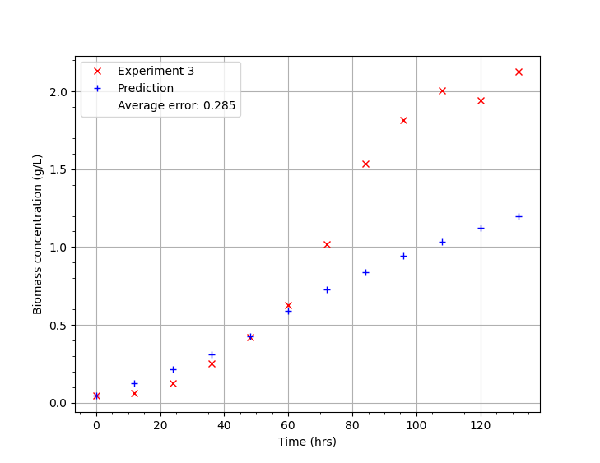
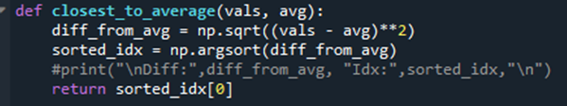

Prediction plots
Each set of hyper-parameters will be evaluated 10 times over, this would give 10 different MSE values and 10 corresponding sets of prediction data.
Averaging the MSE values is a valid means of analysis but averaging the prediction data is not. This would smooth out any distinct features of the prediction plots.
To choose which set of prediction plots to use, I find whichever value is closest to the mean from the 10 MSE values (closest_to_average()). I use the 5 prediction plots and 5 individual testing set MSE data from this value.
Images: Left shows a prediction plot for experiment 3 data for the hyperparameters HN (6, 2), 360 Epochs, 178 Batch size and 0.011 learning rate. The average MSE for all 5 prediction plots was 0.2425. Below shows the functions and relevant code used to select the prediction plot using the value which is closest to the calculated average.

Slide 53
Optimal hyperparameters: FNN
Here the 5 lowest MSE values are displayed, in order of lowest to highest, from a grid search and random search of the FNN
Grid Search: 1) HN: (4, 4), Epochs: 150, Batch Size: 10, Learn rate: 0.0002, MSE: 0.01899 2) HN: (4, 4), Epochs: 300, Batch Size: 200, Learn rate: 0.0004, MSE: 0.01942 3) HN: (4, 4), Epochs: 300, Batch Size: 300, Learn rate: 0.0004, MSE: 0.01943 4) HN: (6, 4), Epochs: 10, Batch Size: 50, Learn rate: 0.0040, MSE: 0.01973 5) HN: (4, 2), Epochs: 50, Batch Size: 50, Learn rate: 0.0010, MSE: 0.01977
Random Search: 1) HN: (4, 2), Epochs: 389, Batch Size: 121, Learn rate: 0.0003, MSE: 0.01897 2) HN: (4, 4), Epochs: 256, Batch Size: 245, Learn rate: 0.0004, MSE: 0.02032 3) HN: (4, 4), Epochs: 52, Batch Size: 234, Learn rate: 0.0017, MSE: 0.02088 4) HN: (6, 4), Epochs: 113, Batch Size: 73, Learn rate: 0.0004, MSE: 0.02102 5) HN: (4, 2), Epochs: 366, Batch Size: 239, Learn rate: 0.0005, MSE: 0.0211

Slide 54
Optimal hyperparameters: FNN
Here the optimal configurations identified from 4 runs of 250 evaluations for Bayesian Optimization and Random Forest are shown below.
Gaussian Process Bayesian Optimization: HN: (4, 8), Epochs: 40, Batch Size: 105, Learn rate: 0.0782, MSE: 0.0225473 HN: (4, 2), Epochs: 133, Batch Size: 143, Learn rate: 0.0008, MSE: 0.0240329 HN: (4, 8), Epochs: 60, Batch Size: 87, Learn rate: 0.0804, MSE: 0.0265405 HN: (4, 10), Epochs: 226, Batch Size: 162, Learn rate: 0.0498, MSE: 0.0201380
Random Forest: HN: (6, 8), Epochs: 52, Batch Size: 256, Learn rate: 0.0515, MSE: 0.0246905 HN: (4, 8), Epochs: 119, Batch Size: 265, Learn rate: 0.0912, MSE: 0.0232382 HN: (4, 6), Epochs: 355, Batch Size: 157, Learn rate: 0.0858, MSE: 0.0258024 HN: (4, 10), Epochs: 59, Batch Size: 184, Learn rate: 0.0465, MSE: 0.0277703

Slide 55
Optimal hyperparameters: RNN
Here the 5 lowest MSE values are displayed, in order of lowest to highest, from a grid search and random search of the RNN.
Grid Search:
1) HN: 4, Epochs: 25, Batch Size: 200, Learn rate: 0.1000, MSE: 0.02127
2) HN: 2, Epochs: 50, Batch Size: 250, Learn rate: 0.1000, MSE: 0.02177
3) HN: 6, Epochs: 350, Batch Size: 10, Learn rate: 0.0001, MSE: 0.02245
4) HN: 6, Epochs: 10, Batch Size: 80, Learn rate: 0.1000, MSE: 0.02247
5) HN: 2, Epochs: 25, Batch Size: 50, Learn rate: 0.0100, MSE: 0.02252
Random Search:
1) HN: 4, Epochs: 264, Batch Size: 166, Learn rate: 0.0013, MSE: 0.02197
2) HN: 3, Epochs: 43, Batch Size: 229, Learn rate: 0.0669, MSE: 0.02269
3) HN: 5, Epochs: 295, Batch Size: 195, Learn rate: 0.0013, MSE: 0.02304
4) HN: 3, Epochs: 382, Batch Size: 122, Learn rate: 0.0533, MSE: 0.02307
5) HN: 2, Epochs: 96, Batch Size: 210, Learn rate: 0.0933, MSE: 0.02322

Slide 56
Optimal hyperparameters: RNN
Here the optimal configurations identified from 4 runs of 250 evaluations for Bayesian Optimization and Random Forest are shown below.
Gaussian Process Bayesian Optimization: HN: 2, Epochs: 181, Batch Size: 127, Learn rate: 0.0412, MSE: 0.0265513 HN: 2, Epochs: 120, Batch Size: 37, Learn rate: 0.0176, MSE: 0.0256411 HN: 2, Epochs: 237, Batch Size: 139, Learn rate: 0.0377, MSE: 0.0280923 HN: 7, Epochs: 329, Batch Size: 30, Learn rate: 0.0057, MSE: 0.0247069
Random Forest: HN: 2, Epochs: 260, Batch Size: 195, Learn rate: 0.0318, MSE: 0.0247944 HN: 9, Epochs: 381, Batch Size: 135, Learn rate: 0.0003, MSE: 0.0325094 HN: 2, Epochs: 252, Batch Size: 105, Learn rate: 0.0301, MSE: 0.0264637 HN: 9, Epochs: 348, Batch Size: 82, Learn rate: 0.0989, MSE: 0.0316177

Slide 57
High data variation
Despite looping 10 network evaluations, there is still significant variation in the results. From the results I identified the lowest MSE (average of 10). From two sets of evaluations, I concluded different results. This makes it hard to identify the ‘optimal’ solution from a set of ‘optimal’ solutions. See below.
From Network Evaluations 1.txt. Lowest MSE for each method:
Random Search MSE 0.0366 HN: (4, 4), Epochs: 256, Batch Size: 245, Learn rate: 0.0004
Grid Search: MSE 0.0386 HN: (4, 2), Epochs: 50, Batch Size: 50, Learn rate: 0.0010
Random Forest: MSE 0.0394 HN: (4, 10), Epochs: 59, Batch Size: 184, Learn rate: 0.0465
Bayesian: MSE 0.0469 HN: (2, 8), Epochs: 71, Batch Size: 106, Learn rate: 0.0114
From Network Evaluations 2.txt. Lowest MSE for each method:
Grid: MSE 0.0351 HN: (4, 4), Epochs: 150, Batch Size: 10, Learn rate: 0.0002
Random: MSE 0.0396 HN: (4, 4), Epochs: 52, Batch Size: 234, Learn rate: 0.0017
Random Forest: MSE 0.0390 HN: (4, 6), Epochs: 355, Batch Size: 157, Learn rate: 0.0858
Bayesian: MSE 0.0397 HN: (10, 8), Epochs: 334, Batch Size: 31, Learn rate: 0.1000
I tested one configuration 12 times, giving a total of 120 evaluations since each test loops 10 times. HN: (2, 8), Epochs: 71, Batch Size: 106, Learn rate: 0.0114. This gave the MSE value results;
[0.0744,0.0567,0.0742, 0.0811,0.0469,0.0914, 0.0822, 0.0481, 0.0668, 0.0412, 0.0677, 0.0522] (12 runs of script)
Mean = 0.0652 +/- 0.0154. i.e. a standard deviations of +/- 24% !!!
To rectify this, I will instead evaluate each set of hyperparameters 100 times. This will give a statistically significant sample size and much more consistent means and standard deviations. Then I will carefully compare the both mean and the standard deviation to help me pick out optimal hyperparameters. In following slides, each hyperparameter set was evaluated 100 times, the optimal value found from each tuning method was evaluated a further 200 times.

Slide 58
Comparing the optimal solutions
The optimal solution for each method for both the RNN and FNN was identified. Each of these will undergo 200 further evaluations and have their prediction data plotted. From these plots I will compare between FNN and RNN output for each method. After analysing the prediction plots (shown in following slides) enabled a grade to be given to the performance of each method, relative to the same Network type (FFN grades not correlated to RNN, standalone between networks).
FNN: Grid - HN: (4,2), Epochs: 50, Batch Size: 50, Learn rate: 0.001, MSE: (0.0321 ± 0.0059) A/B (as good as Bayesian) Random - HN: (6,4), Epochs: 113, Batch Size: 73, Learn rate: 0.0004, MSE: (0.0318 ± 0.0051) C R Forest - HN: (4,10), Epochs: 59, Batch Size: 184, Learn rate: 0.0465, MSE: (0.0416 ± 0.0100) D Bayesian - HN: (4,2), Epochs: 133, Batch Size: 143, Learn rate: 0.0008, MSE: (0.0332 ± 0.0060) A/B
RNN: Grid - HN: 6, Epochs: 350, Batch Size: 10, Learn rate: 0.0001, MSE: (0.0425 ± 0.0067) C Random - HN: 4, Epochs: 264, Batch Size: 166, Learn rate: 0.0013, MSE: (0.0404 ± 0.0100) B R Forest - HN: 9, Epochs: 381, Batch Size: 135, Learn rate: 0.0003 MSE: (0.0361 ± 0.0048) A Bayesian - HN: 2, Epochs: 120, Batch Size: 37, Learn rate: 0.0176, MSE: (0.0581 ± 0.0237) D
For the FNN, each method, besides random forest, identified hyperparameters which consistently gave low errors. It can also be inferred that epochs and learning rate are the two most significant hyperparameters. Batch size is not as significant, if it was, we would see batch sizes lower than 100 in all cases as per the 2D epoch v batch size heat map plot. However, it does still contribute to the overall accuracy to some degree as all batch size values are less than 200 (300 was our upper limit). Hidden neuron configurations do not seem to have too much of an effect, although using the more optimal of these enables access to even lower errors.
This was not the case for the RNN. Only grid search and random forest found optimal values which gave a reasonably low mean squared error. The random search configuration had a particularly bad performance, with a very high MSE and variance despite lying within the optimal region as would be concluded according to the heat map analysis.

Slide 59
Prediction plots
The following slides will show 5 prediction plots for each method, for both the FNN and RNN in turn. The average error from the testing set used for the particular plot, is displayed in the legend.
Some selected plots will be produced to show the most optimal configuration and to illustrate some comparisons.

Slide 60
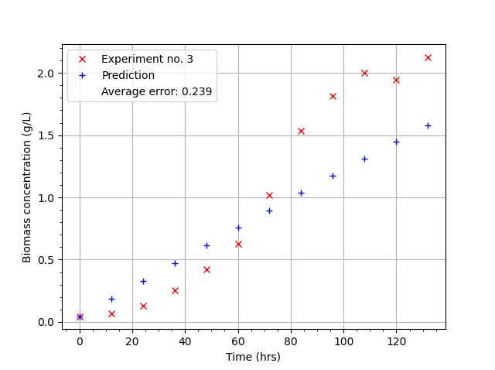
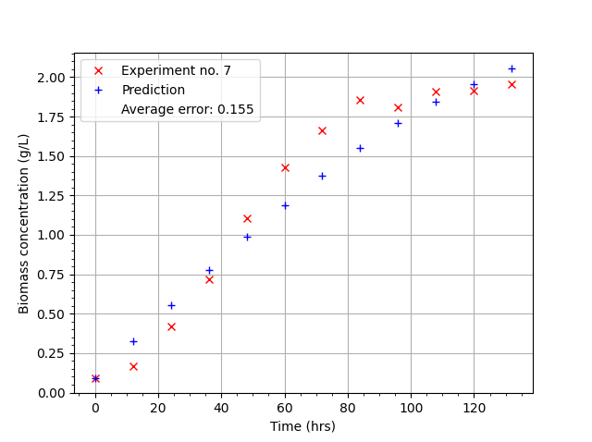
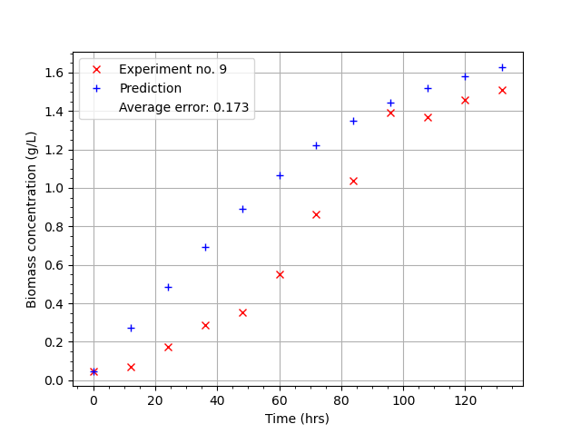
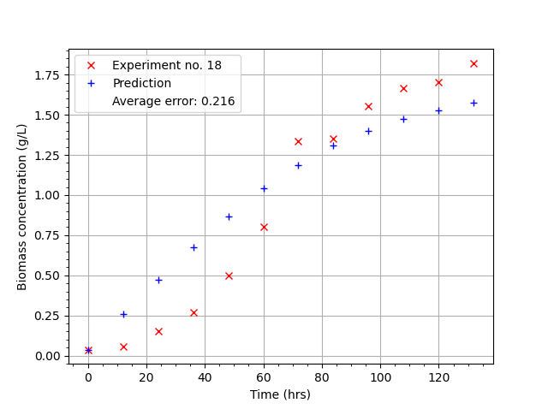
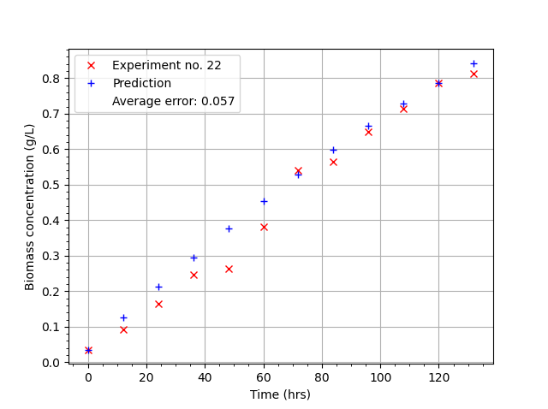
FNN Grid Search
HN: (4, 2), Epochs: 50, Batch Size: 50, Learn rate: 0.0010
MSE: (0.0321 ± 0.0059),
Mean Error: (0.1783 ± 0.0169)
3 good plots (7, 18, 22) A/B
2 decent (3, 9)

Slide 61
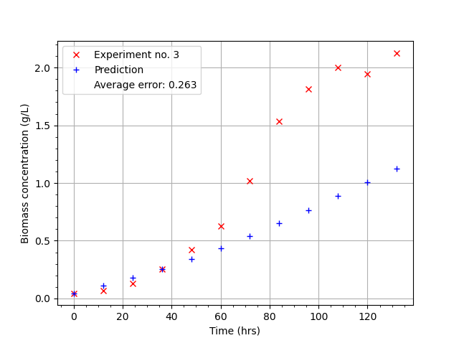
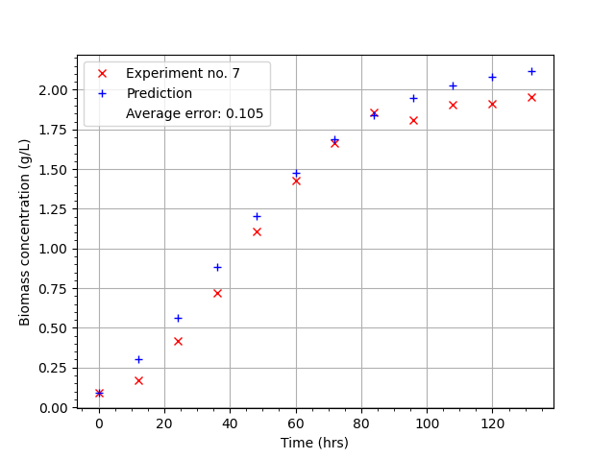
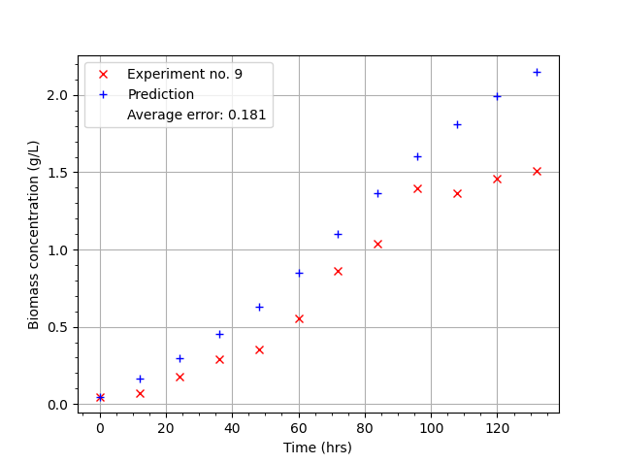
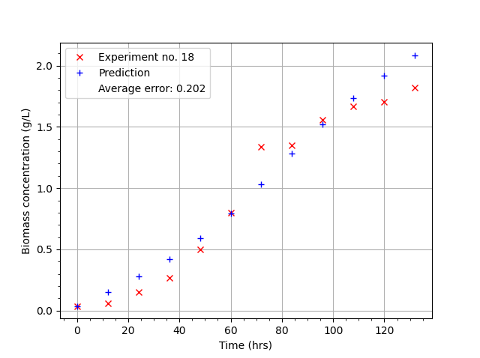
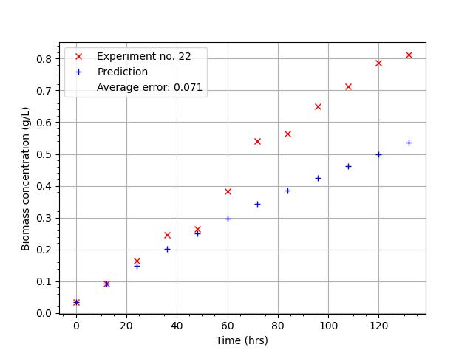
FNN Random Search
HN: (6, 4), Epochs: 113, Batch Size: 73, Learn rate: 0.0004
MSE: (0.0318 ± 0.0051),
Mean Error: (0.1777 ± 0.0144)
2 good plots (7,18) C
1 decent plot (9)
2 bad (3,22)

Slide 62
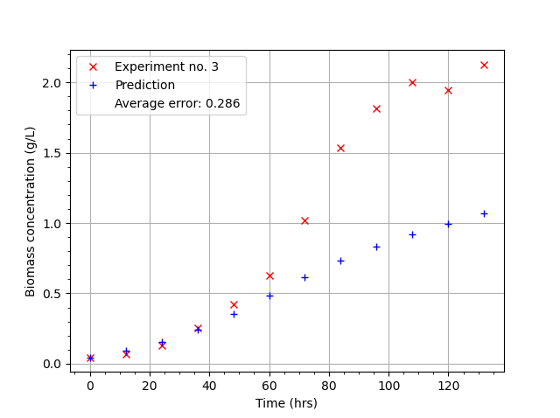
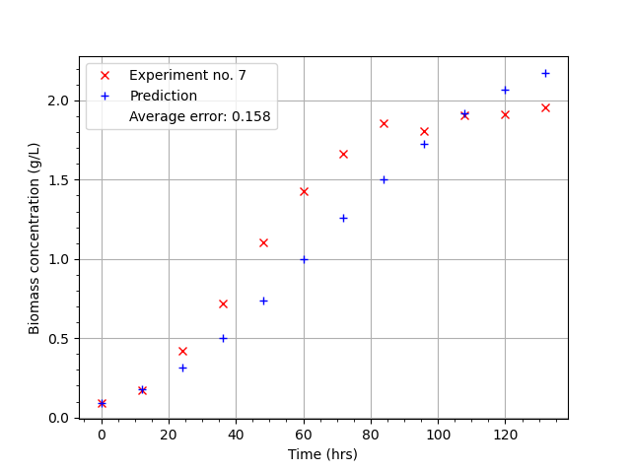
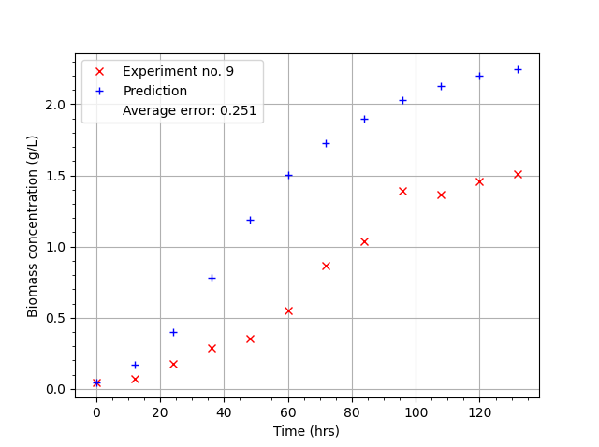
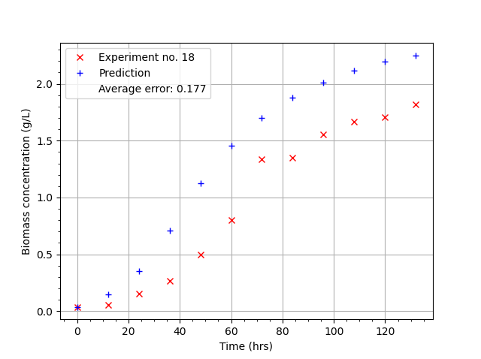
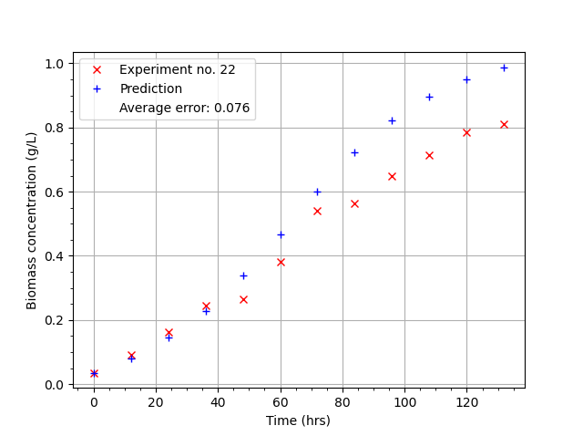
FNN Random Forest
HN: (4, 10), Epochs: 59, Batch Size: 184, Learn rate: 0.0465
MSE: (0.0416 ± 0.0100),
Mean Error: (0.2026 ± 0.0233)
1 good (7) D
2 decent (18,22)
2 bad (3,9)

Slide 63
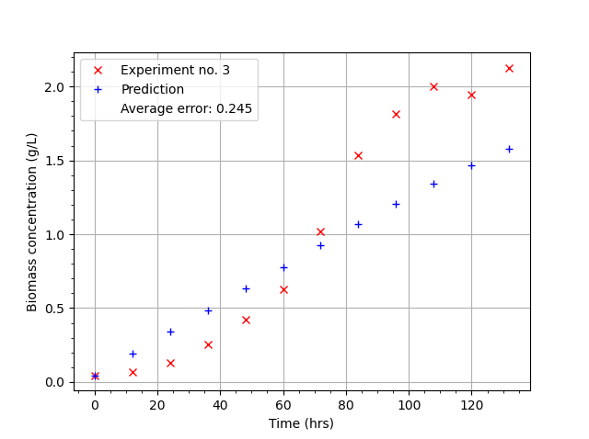
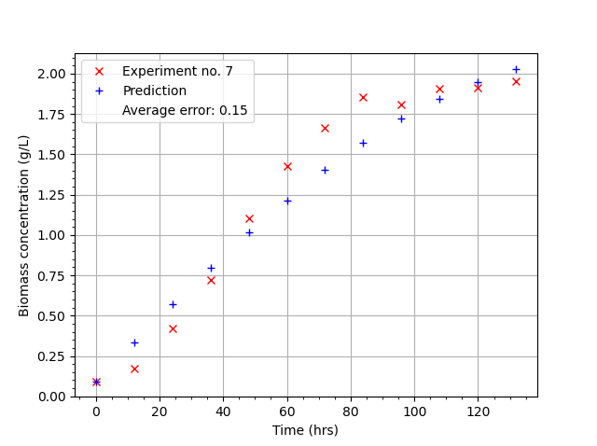
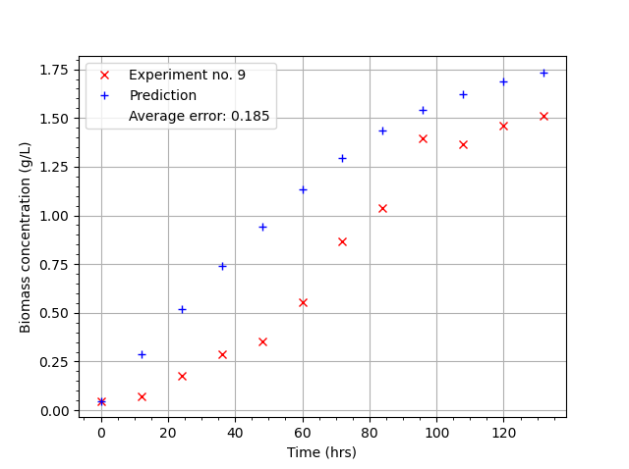
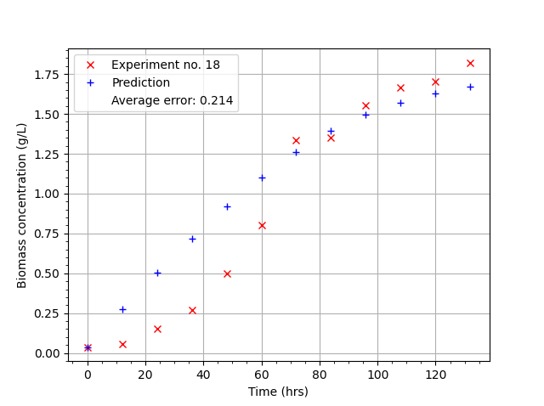
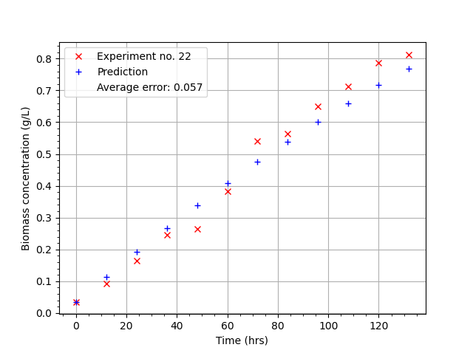
FNN Bayesian
HN: (4, 2), Epochs: 133, Batch Size: 143, Learn rate: 0.0008
MSE: (0.0332 ± 0.0060),
Mean Error: (0.1814 ± 0.0170)
3 good plots (7,18,22) A/B
2 decent (3,9)
(same as grid search)

Slide 64
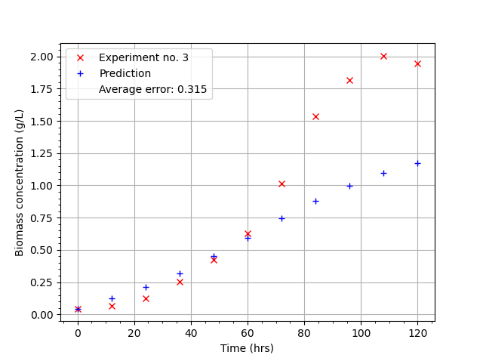




RNN Grid Search
HN: 6, Epochs: 350, Batch Size: 10, Learn rate: 0.0001 MSE(0.0425 ± 0.0067),
Mean Error: (0.2056 ± 0.0162)
1 good plot (7) C
1 decent (18)
3 bad (3,9,22)

Slide 65





RNN Random Search
HN: 4, Epochs: 264, Batch Size: 166, Learn rate: 0.0013 MSE(0.0404 ± 0.0100),
Mean Error: (0.1994 ± 0.0248)
3 good plots ( 7, 18, 22) B
2 bad plot (3, 9)
The prediction is very linear and underfitted. No attempt to match the data curving.

Slide 66





RNN Random Forest
HN: 9, Epochs: 381, Batch Size: 135, Learn rate: 0.0003 MSE: (0.0361 ± 0.0048), Mean Error: (0.1895 ± 0.0125)
3 good plots (7, 18, 22) A
1 decent (9)
1 bad (3)
The only RNN configuration to get an MSE below 0.0400

Slide 67





RNN Bayesian
HN: 2, Epochs: 120, Batch Size: 37, Learn rate: 0.0176 MSE: (0.0581 ± 0.0237),
Mean Error: (0.2364 ± 0.0475)
2 decent (18, 22) D
3 bad (3, 7, 9)

Slide 68
Plot analysis
A direct comparison between the 2 layer FNN and single layer RNN is yet to be made. However from the prediction plots there is already definite indication that the FNN outperformed the RNN.
There are two possible conclusions for this:
1) The 2 layer FNN is more adaptable to the experimental data than the RNN and as such, is the better choice. The 5 testing data sets curve significantly, following shapes respective of high order polynomials. As such this data is hard to predict and fit to, despite this, the FNN still manages to consistently produce good predictions plots. On the contrary, the RNN struggles to predict the experimental data, even when using the 'optimal' hyperparameters found by the different tuning methods.
2) The different tuning methods did not find successfully find optimal hyperparameters for the RNN. This means it can't necessarily compete against the FNN as its unfairly inhibited by sub-optimal hyperparameters. The RNN hyperparameter exploration and investigation was extensive however the network testing regime is limited and could be skewing the optimisation results.
N.B. The current testing regime outputs a single MSE value, averaged from 5 testing sets. This is not ideal, for several reasons. Firstly, the single MSE value is not representative of the hyperparameters, as discussed in the previous slide ‘High data variation’, some hyperparameters are identified as optimal when their value was at the tail end of a wide MSE distribution. Only after averaging 100 evaluations of the networks were consistent averages and standard deviations obtained. Second, simply averaging the 5 MSE values from each testing set does not account for the scale of data. This can be seen on some of the prediction plots. Some plots have a small axis with the prediction varying significantly from the experiment, however, the error is still small compared to other plots which may have better prediction but have a larger axis. A fractional/percentage error approach would be better than using absolute error.
In hindsight I would've implemented a more rigorous testing regime, averaging the percentage error between testing sets and using a statistically significant number of evaluation repeats. This could possibly be used in a 3rd case study into FNNs Vs RNNs.

Slide 69



FNN
RNN

Slide 70
RNN Random Forest
HN: 9, Epochs: 381, Batch Size: 135, Learn rate: 0.0003 MSE: (0.0361 ± 0.0048), Mean Error: (0.1895 ± 0.0125)
3 good plots (7, 18, 22) A
1 decent (9)
1 bad (3)
The only RNN configuration to get an MSE below 0.0400

Slide 71
FNN Bayesian
HN: (4, 2), Epochs: 133, Batch Size: 143, Learn rate: 0.0008
MSE: (0.0332 ± 0.0060),
Mean Error: (0.1814 ± 0.0170)
3 good plots (7,18,22) A/B
2 decent (3,9)
(same as grid search)

Slide 72
Comparing the RNN to the FNN, using ‘A grade’ hyperparameters, we see that the performance is similar. The RNN is slightly better than the FNN. However, this is the only RNN hyperparameter configuration which is able to contend with the FNN’s performance. Overall, the FNN had multiple sets of hyperparameters which gave optimal performance, whereas the other RNN configurations are generally sub-optimal.
RNN Random Forest HN: 9, Epochs: 381, Batch Size: 135, Learn rate: 0.0003 MSE: (0.0361 ± 0.0048).
FNN Bayesian HN: (4, 2), Epochs: 133, Batch Size: 143, Learn rate: 0.0008, MSE: (0.0332 ± 0.0060).

Slide 73

FNN v RNN comparison
See Bayesian evaluation and Random Search evaluation .txt files for MSE comparisons.
Table is only partial.

Slide 74
End of Week 7
It was concluded that the prediction plots shown in the previous slides were not that optimal, they merely plot a fairly linear line through all the data. This is possibly due to most optimal configurations only having low learning rates between 0.0001 and 0.001 and epoch numbers lower than 400.
By extending the domain search to include higher epoch numbers and searching above a learning rate of 0.001, better prediction plots may be obtained.
This fine-tuning would always be performed anyway. The optimal-hyperparameters obtained from the different tuning methods can be used as our starting point. Once fine-tuned hyperparameters have been found for both the FNN and RNN, then a full performance comparison can be performed and conclusions drawn.

Slide 75
Week 8
After the points raised from last week, further analysis is required.
Modify network training regime to output the Training MSE.
Improve the testing regime to iterate over several samples to obtain a mean and standard deviation for each set of hyperparameters.
Move Experiment 3 data from the testing set into the training set.
Extend the search domain to access higher epoch numbers, 0 to 1000. Also search above a learning rate of 0.001.

Slide 76


Improved network training and testing regime
Like in the network evaluation the previous week, all network training and testing was repeated at least 10 times over.
The training regime was modified to average the MSE from every single data point during training.

Slide 77

Improved network training and testing regime
Repeating the Training and testing regime several times over has drastically improved the performance of the Bayesian optimisation algorithm. The output from a neural network can vary significantly due to the nature of the Stochastic Gradient Descent and back propagation processes. However, good hyperparameter sets should give relatively consistent performance with only limited variance. From multiple evaluations of the same hyperparameter set, the mean and standard deviation of the results can be combined and used as a measurement of the objective function for Bayesian Optimization. In this project, the average MSE output from n_sample iterations is summed with half the standard deviation of the different MSE values (avg_mse + std_dev/2). This weights the Bayesian algorithm to select for hyperparameter sets with lower error and standard deviation. So far this has been very beneficial as the few Bayesian scripts run have all outputted good sets of hyperparameters whereas before, the script output was sometimes an anomalous and unpredictable.
Figure: The console output during a run of the Bayesian optimisation script (note this is the initial random seeding). GP_output is the return value of the objective function evaluated by the Bayesian algorithm. GP_output = MSE value + half its error.
The training MSE is also shown although not used to weight the output in any way.

Slide 78


Fine tuning parameters for the FNN
A Bayesian search identified the hyperparameters of HN (4, 2), 200 Epochs, 300 Batch size and a learning rate of 0.0008 as an optimal configuration. 1D grid searches were performed and the results plotted. The plots show that increasing the epoch number beyond 400 did not improve the predictive capabilities of this particular FNN structure. Also, the low learning rate means that the prediction plots were still fairly linear.

Slide 79


Fine tuning parameters for the FNN
A Bayesian search identified the hyperparameters of HN (8, 4), 548 Epochs, 200 Batch size and a learning rate of 0.00015 as an optimal configuration. By performing a 1D grid search and plotting the results seen below, this was confirmed. Increasing the epoch number beyond 400 improved the predictive capabilities of this particular FNN structure, with a minimum around 450 to 550 epochs. However, only a low learning rate gave sufficient predictive capabilities which results in fairly linear prediction plots.

Slide 80


Fine tuning parameters for the FNN
From the previous learning rate plot for the hyperparameters of HN (8, 4), 548 Epochs and a Batch size of 200, the learning rate with the lowest error was within the range of 0.001 to 0.0001. This was further investigated by sampling 30 from the range. This plot is shown below on the left, the optimal learning rate lies within the range of 0.00012 to 0.00018. The initial Bayesian search outputted the learning rate of 0.00015, so it had already identified the optimised value. From plotting the batch size we can see that gain, the optimal value had already been selected by Bayesian Optimisation. This is the major benefit of using multiple iterations to average over for the training and testing regime.

Slide 81
Fine tuning parameters for the FNN
As in the previous slides Bayesian searches found good sets of hyperparameters. However these still have low learning rates.
More searches were conducted with the learning rate range set to 0.05 to 0.001.
Hopefully optimal sets with higher learning rate will produce prediction plots that are less linear and better follow the data.
What the previous graphs show, is that we can rely on Bayesian Optimisation to find an optimal set of hyperparameters without needing to do any further checks.

Slide 82
Optimal hyperparameters
From the fine tuned Bayesian searches, several sets of optimal hyperparameters were identified for both the FNN and RNN. The best 4 optimal sets for each architecture were chosen for further analysis and are shown below.
FNN hyperparameter sets
1) HN (8, 4), Epochs 245, Batch Size 55, Learning Rate 0.00015, MSE (0.0308 ± 0.0014), Train MSE (0.0350 ± 0.0095)
2) HN (8, 4), Epochs 510, Batch Size 200, Learning Rate 0.00015, MSE (0.0309 ± 0.0019), Train MSE (0.0369 ± 0.0074)
3) HN (8, 4), Epochs 186, Batch Size 20, Learning Rate 0.00010, MSE (0.0313 ± 0.0020), Train MSE (0.0340 ± 0.0028)
4) HN (4, 4), Epochs 800, Batch Size 100, Learning Rate 0.00010, MSE (0.0315 ± 0.0021), Train MSE (0.0333 ± 0.0049)
RNN hyperparameter sets
1) HN 25, Epochs 36, BS 1, LR 0.000106, MSE (0.0335 ± 0.0012), Train MSE (0.0338 ± 0.0012)
2) HN 30, Epochs 141, BS 77, LR 0.000443, MSE (0.0341 ± 0.0015), Train MSE (0.0349 ± 0.0023)
3) HN 10, Epochs 50, BS 121, LR 0.002913, MSE (0.0351 ± 0.0024), Train MSE (0.0384 ± 0.0053)
4) HN 23, Epochs 96, BS 103, LR 0.000762, MSE (0.0351 ± 0.0023), Train MSE (0.0368 ± 0.0035)
The prediction plots for the first set of hyperparameters for both the FNN and RNN are shown in the following slides for comparison. However, the majority of all the plots look very similar regardless. The testing sets were changed to the 5th, 10th, 15th and 20th datasets to give fresh prediction plots to analyse. Note that the initial conditions for experiment 20 are at the end of their respective ranges, as such this data tests how good the neural network is at extrapolation beyond the conditions during training. The other 3 sets have roughly mid range initial conditions and as such, test the networks ability to predict interpolated data.

Slide 83





Slide 84





Slide 85
Conclusion – FNN v RNN
The prediction plots in the previous slide show little variation in prediction ability between the FNN and RNN. It was the same case for the other hyperparameter prediction plots too. Both the FNN and RNN were equally good at predicting interpolated data. Both the FNN and RNN failed to correctly predict experiment 20 data which demonstrates their poor ability to deal with extrapolated data.
In any case, the conclusion can be made that a Recurrent Neural Network does not have any particular predictive advantage over a Feed-forward network when predicting data in an offline scenario.

Slide 86
Conclusion – Hyperparameter tuning techniques
This project demonstrated the relative merits and drawbacks for 5 different tuning methods. Each method has its particular usage and application. However, the best method for finding an optimal set of hyperparameters was the Gaussian Process Bayesian Optimisation. The key to this was improving the training and testing regime by repeating the network evaluations and drawing averages and standard deviations. This gave the Bayesian search error values which were much more accurate and representative of the hyperparameters, enabling it to properly find optimal values in only 250 evaluations.
Evolutionary algorithms were not applicable, but surrogate models offer a promising solution to hyperparameter optimisation.

Slide 87
Outlook
For further evaluation predictive capabilities of FNNs and RNN there are a number of things which can be investigated:
Verify the training and testing procedure as well as the error measurement technique. As found during this project, a single training and testing iteration for a set of hyperparameters did not suffice. Iterating this several times over and taking the mean and standard deviation of the outputted error values gave a more accurate and representative error value for each set of hyperparameters. However, this does result in longer execution times than before, when even then I required a computer cluster using up to 80 cores at some points! In addition, different error measurements other than the Mean Squared Error may prove to be a more useful means of evaluation. Future work should verify and implement a more robust training and testing regime to improve execution times while retaining sufficient accuracy.
Accounting for training error. During this project, I did not pay much attention to the training error, only the testing error. However the training error is just as vital a measure of performance as the testing error. Often, the most optimal configuration comes from considering the training and testing error rather than just minimising the testing error alone. Future work should search the literature for common methods of minimising both the testing and training errors.
Predictive performance using interpolated and extrapolated data sets. As found in the final comparison between the FNN and the RNN, both neural networks performed similarly. This included good performance on interpolated data and poor performance on extrapolated data for both architectures. During my project, no thought was given to the concepts of extrapolated and interpolated data. Future work could further investigate the capability of either neural networks to extrapolate their predictions.
Surrogate Evolutionary Algorithms. During the project, evolutionary algorithms were found to be too computationally expensive as by their nature, they required lots of iterations over many generations to come to a whole set of optimal solutions. Despite being unsuitable for the purposes of this project, the offer of finding a whole array of optimal solutions is promising. In literature, lots of different solutions to surrogate based evolutionary algorithms exist to get around the problem of expensive objective functions. Future work could look at developing a surrogate based evolutionary algorithm to work with the current neural networks.

